Slide 2
Azure DevTest Labs
Quique Martínez
Plain Concepts

Slide 3
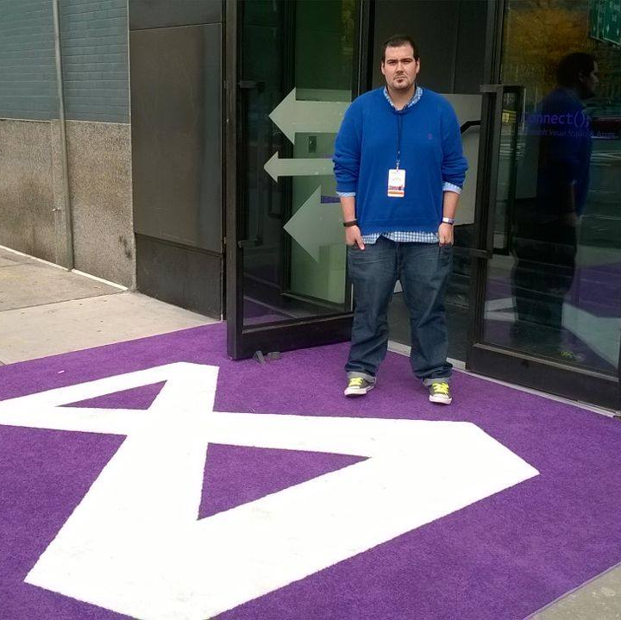


Quique Martínez
Dev & Cloud Team Lead at Plain Concepts
qmartinez@plainconcepts.com
@quiqu3
Microsoft Azure MVP
www.plainconcepts.com
http://quiquemartinez.azurewebsites.net/
Notes:
Let me introduce my self…

Slide 4

We’re hiring for all our offices send an email to qmartinez@plainconcepts.com
Notes:
Plain Concepts was founded 10 years ago
Plain concepts was founded/was born 10 years ago
We have more than 100 employees
We have presence
we have presence / we are present in...
We are proud of our company as we have completed over 1000 projects
Microsoft Certifications: Gold Cloud Platform, Gold Application Development, Gold Application Lifecycle Management, Silver Application Integration, Silver Collaboration and Content.
Other certifications: Xamarin Premium Consulting Partner, Agile Alliance Corporate Member, PixelSense Premier Partner, Premier developer partner for Xbox LIVE Applications, Professional Scrum Developer.
Awards: 1 Microsoft Regional Director, 12 Microsoft Most Valuable Professional (MVP), Windows 8 Applications Partner of the Year, ALM Partner of the Year for 7 consecutive years, FWA: Project Prometheus Training Center.

Slide 5



1 Curso desarrollo apps
Cazando a Javier Suárez
SORTEAMOS SORTEAMOS SORTEAMOS SORTEAMOS
1 Juego Deus EX
Cazando a 5 Speakers
http://bit.ly/plain-go
Notes:
Para entrar en los dos primeros sorteos los usuarios tienen que registrase en la web de plainconceptsgo leyendo el QR, para cazar a un speaker de Plain tendrán que leer el QR correspondiente. Para entrar en el sorteo del dron tienen que ir al stand y acertar todas las preguntas del test

Slide 6
Today…Azure DevTest Lab
Create a lab
Set policies
Set virtual networks
Configure artifact repositories
Manage VM bases
Add lab users
Create a VM
Manage existing VMs
Price

Slide 7



Challenges of running dev-test on premises
Your datacenter
IT admin
VMs in dev-test environment
Developers
Provision VMs
Request VMs
65%
of developers say it is too complicated and time-consuming to get development and test resources
Your challenges
Compromised agility
Limited hardware budget
Limited software licensing
Resource contention with VMs
Realistic scale tests often challenging
Procurement delays
10%
Average utilization of dedicated dev-test infrastructure
Source: Business Case for Test Environment Management Whitepaper, Cognizant

Slide 8

Dev-test in the cloud: drivers and concerns
Drivers
Concerns
Agility
Integration
Economics
Security
IT admin
Scale
Compliance
Speed
Performance

Slide 9
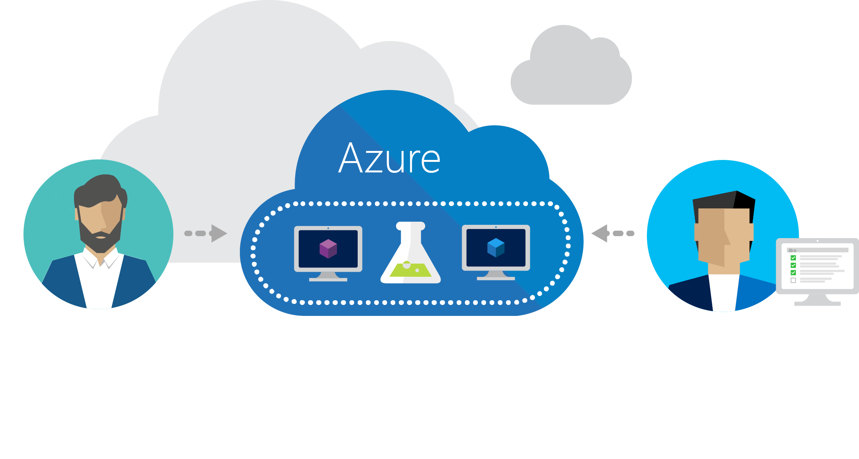
Azure DevTest Labs
Fast, easy, and lean dev-test environments in Azure.
Specifically for your team. On demand.

Slide 10
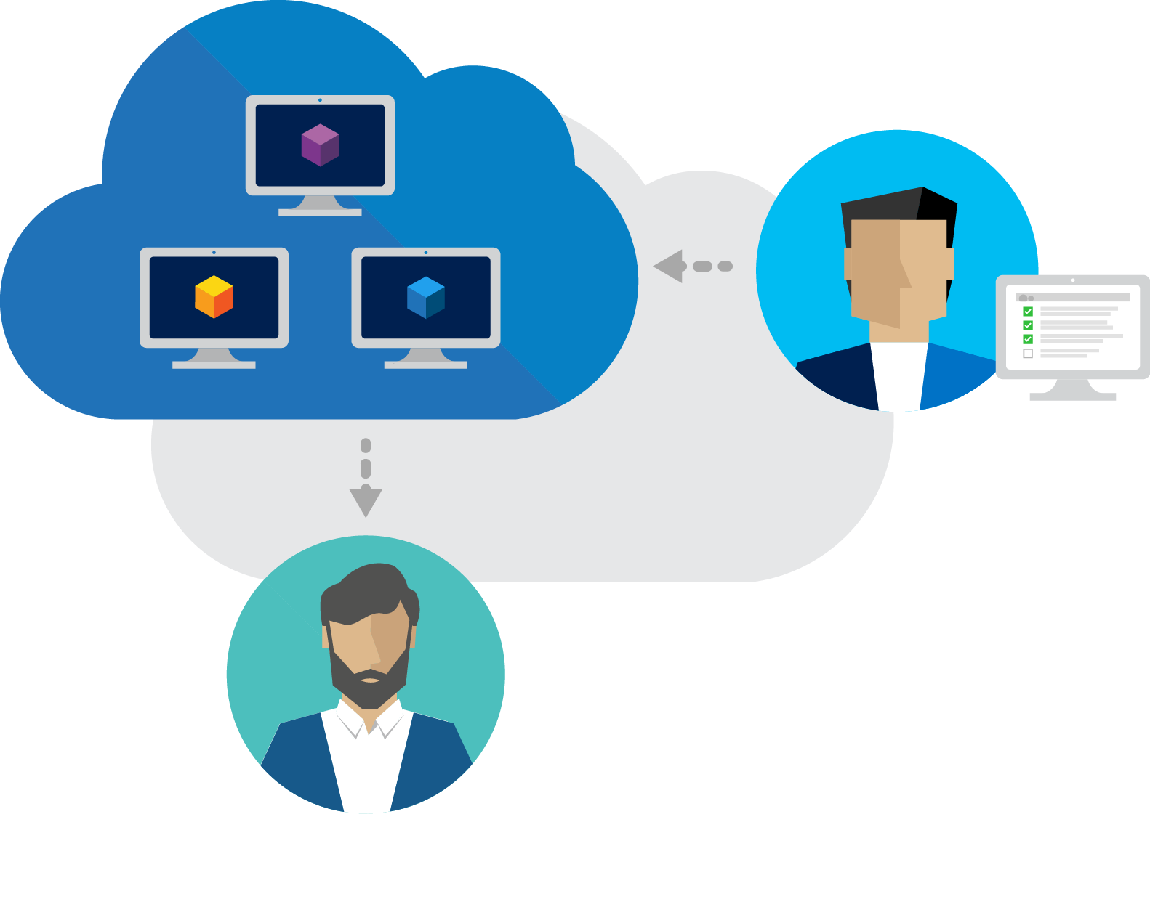
Worry-free self-service
Provision environments with allocated quotas and policies
Control costs
Track project spending
Notes:
Quotas Policies Templates Security Dashboards

Slide 11
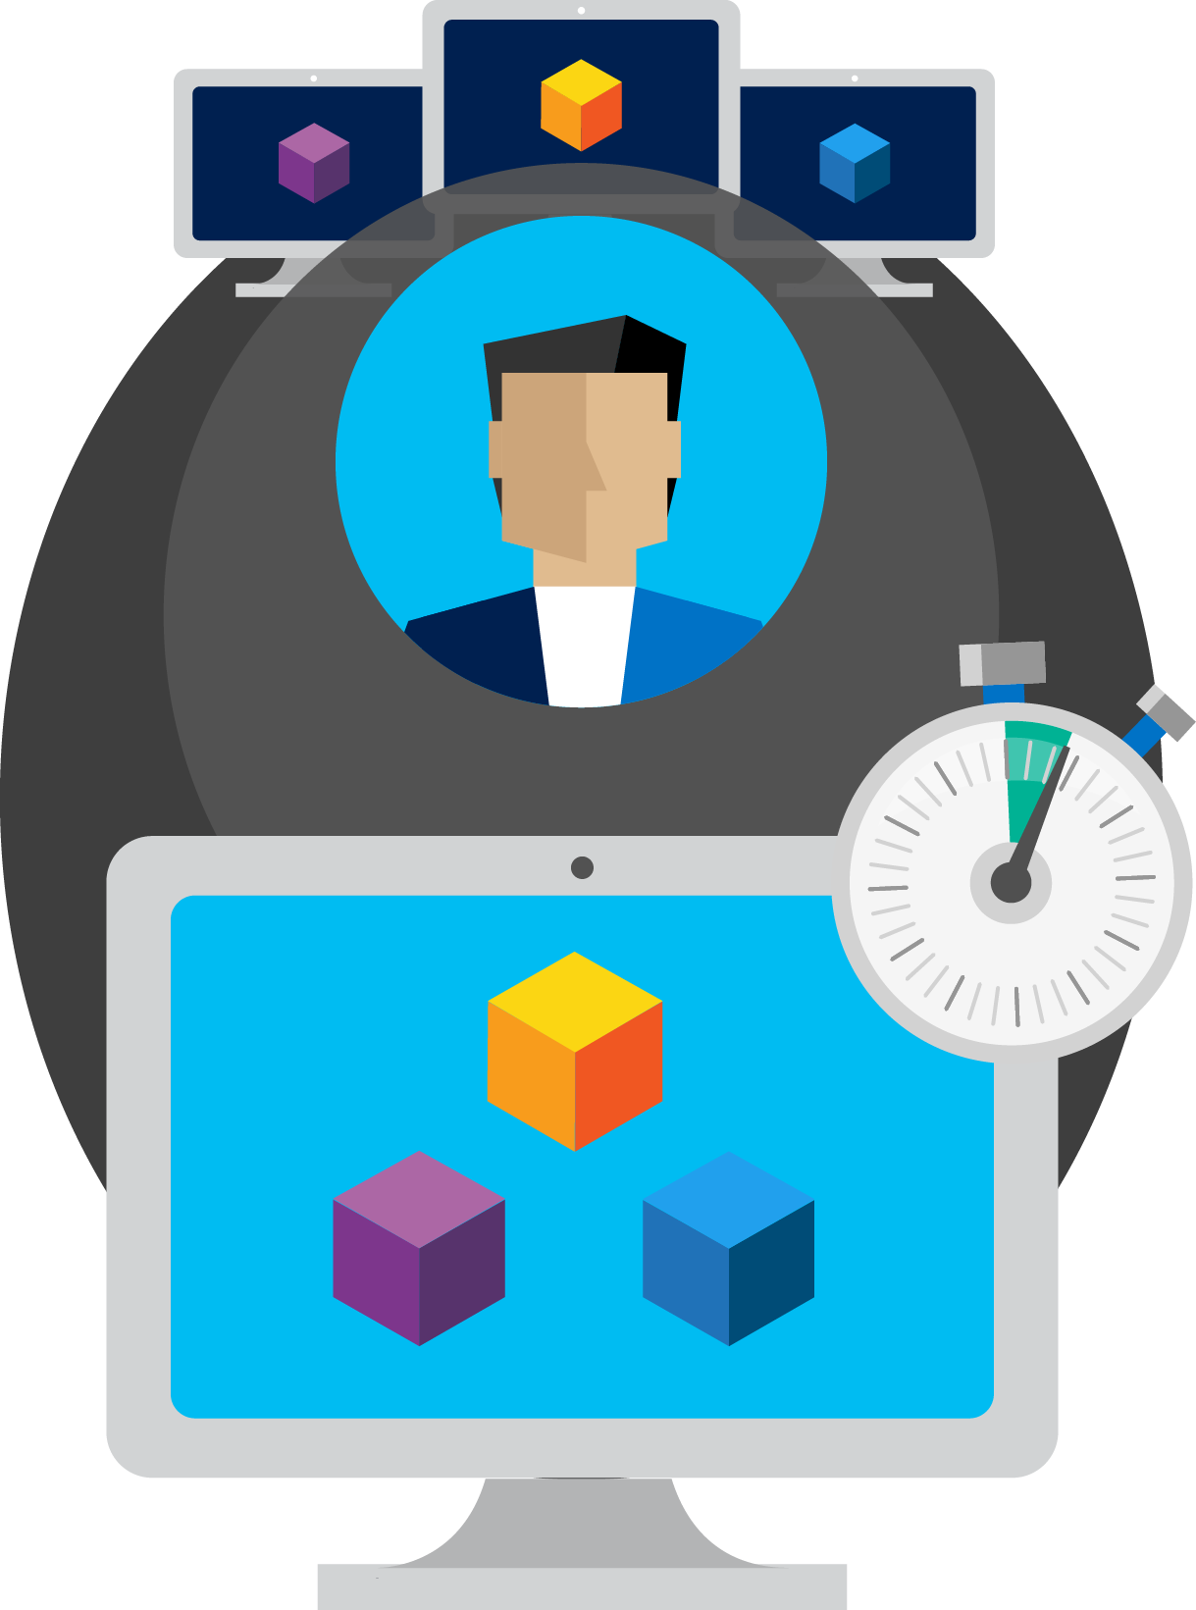
Fast provisioning
Pre-provision environments
Claim an environment and start working immediately
Use containers

Slide 12
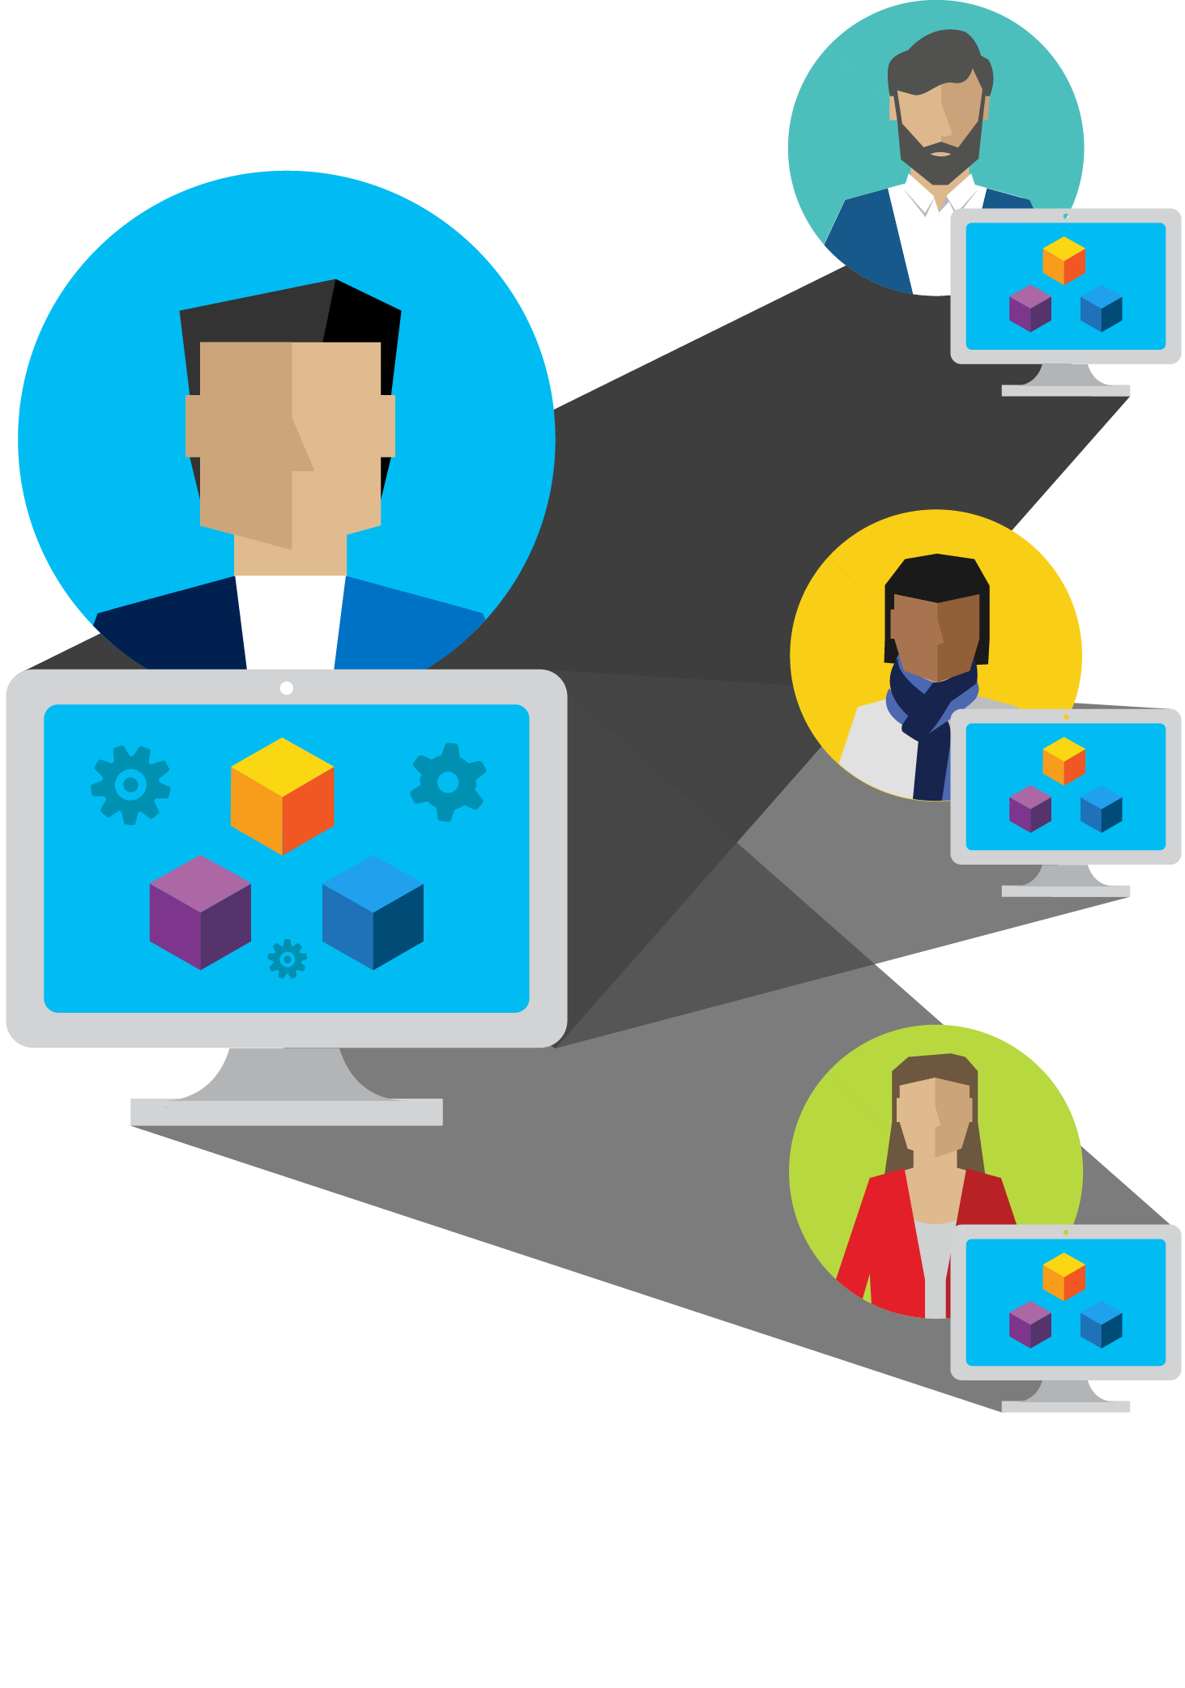
Create once, use everywhere, by everyone
Create templates once
Share templates within your team
Test environments easily

Slide 13

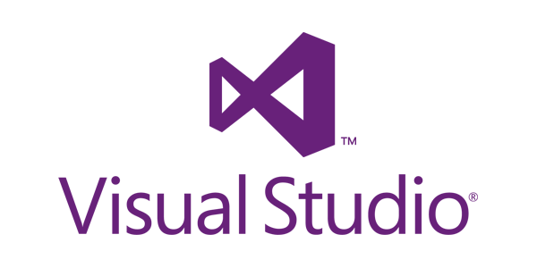

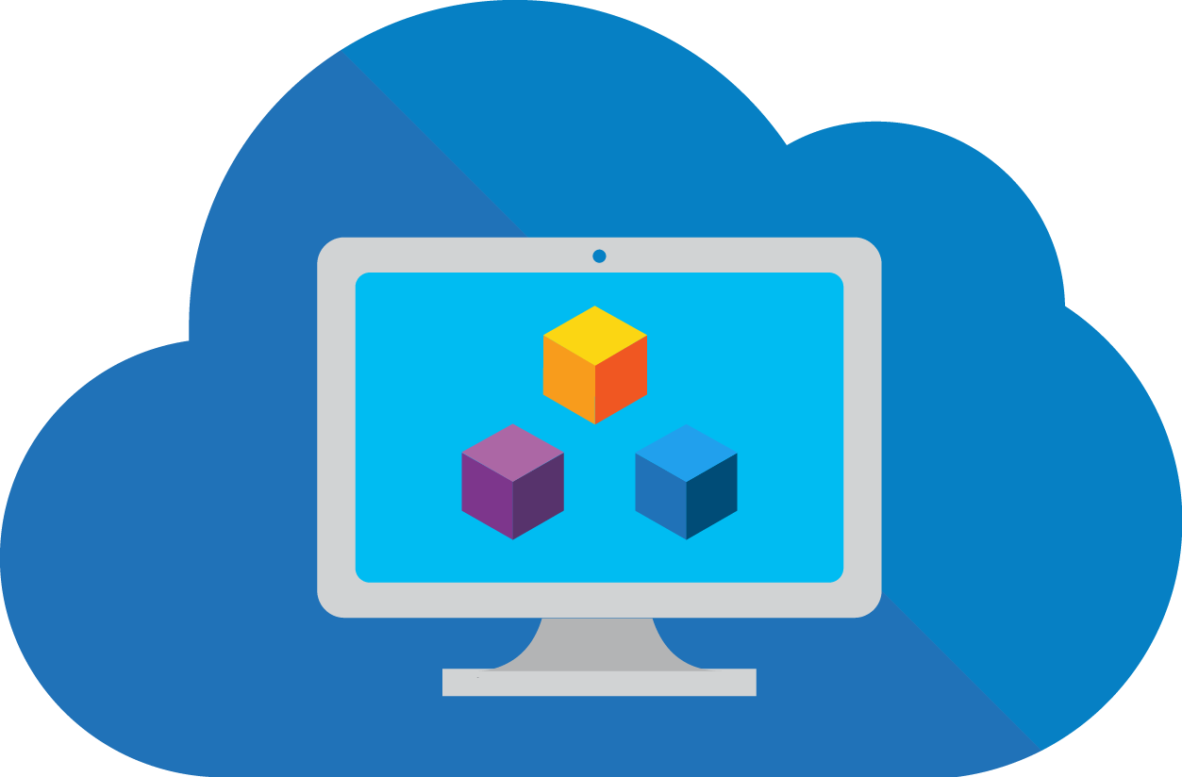




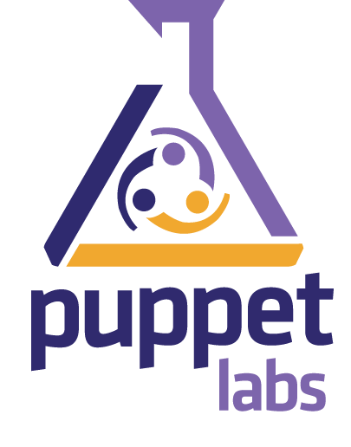
Integrate with your existing toolchain
Leverage premade plug-ins or API
Dev-test from preferred CI tool
Use command line tool

Slide 14
DevTest Labs Scenarios
Dev Box
Test my latest app
Training/Hackathons
Trial/Demo

Slide 15
Demo

Slide 16
What’s in the demo:
Create a lab
Set policies
Set virtual networks
Configure artifact repositories
Manage VM bases
Add lab users
Create a VM
Manage existing VMs
Price

Slide 17
Create a Lab

Slide 18
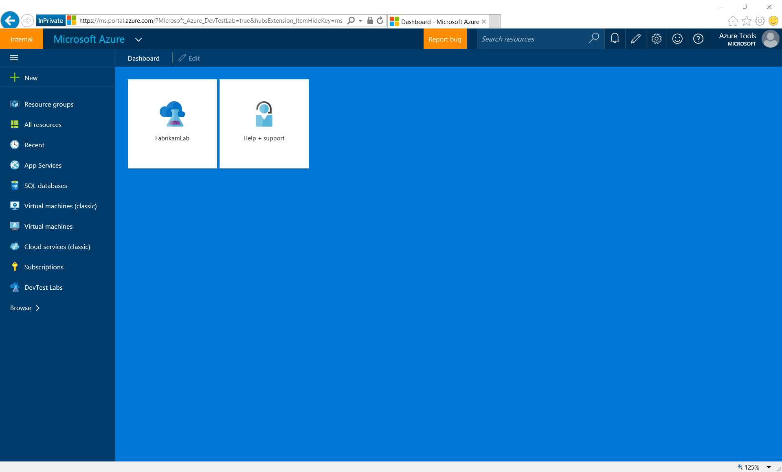
Notes:
Start from the Azure portal…

Slide 19
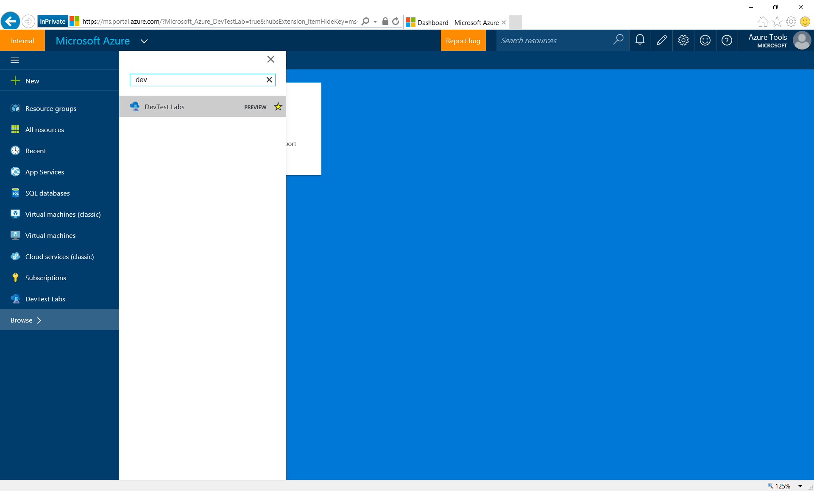
Notes:
In Browse, search for the DevTest Labs to open the Labs blade. You can pin it on the quick start navigation menu on the left.

Slide 20
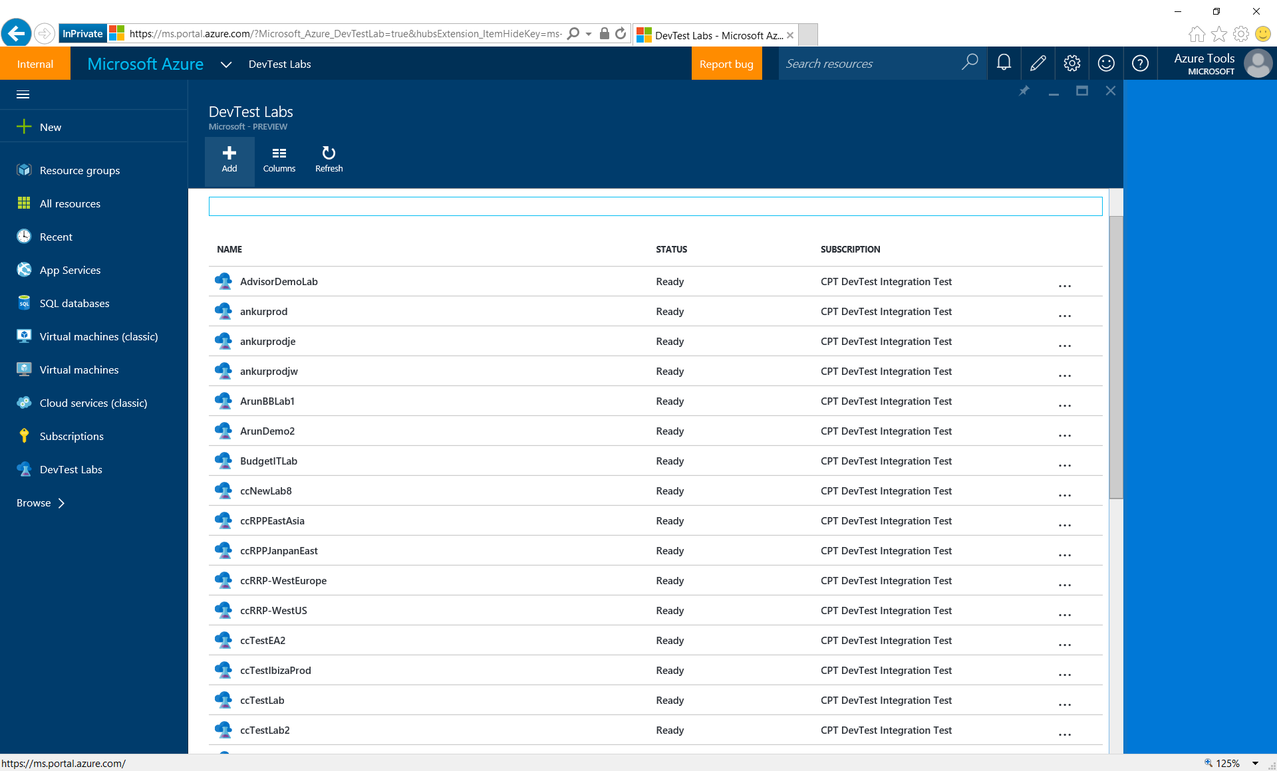
Notes:
Create a new lab by clicking the Add button on the top.

Slide 21
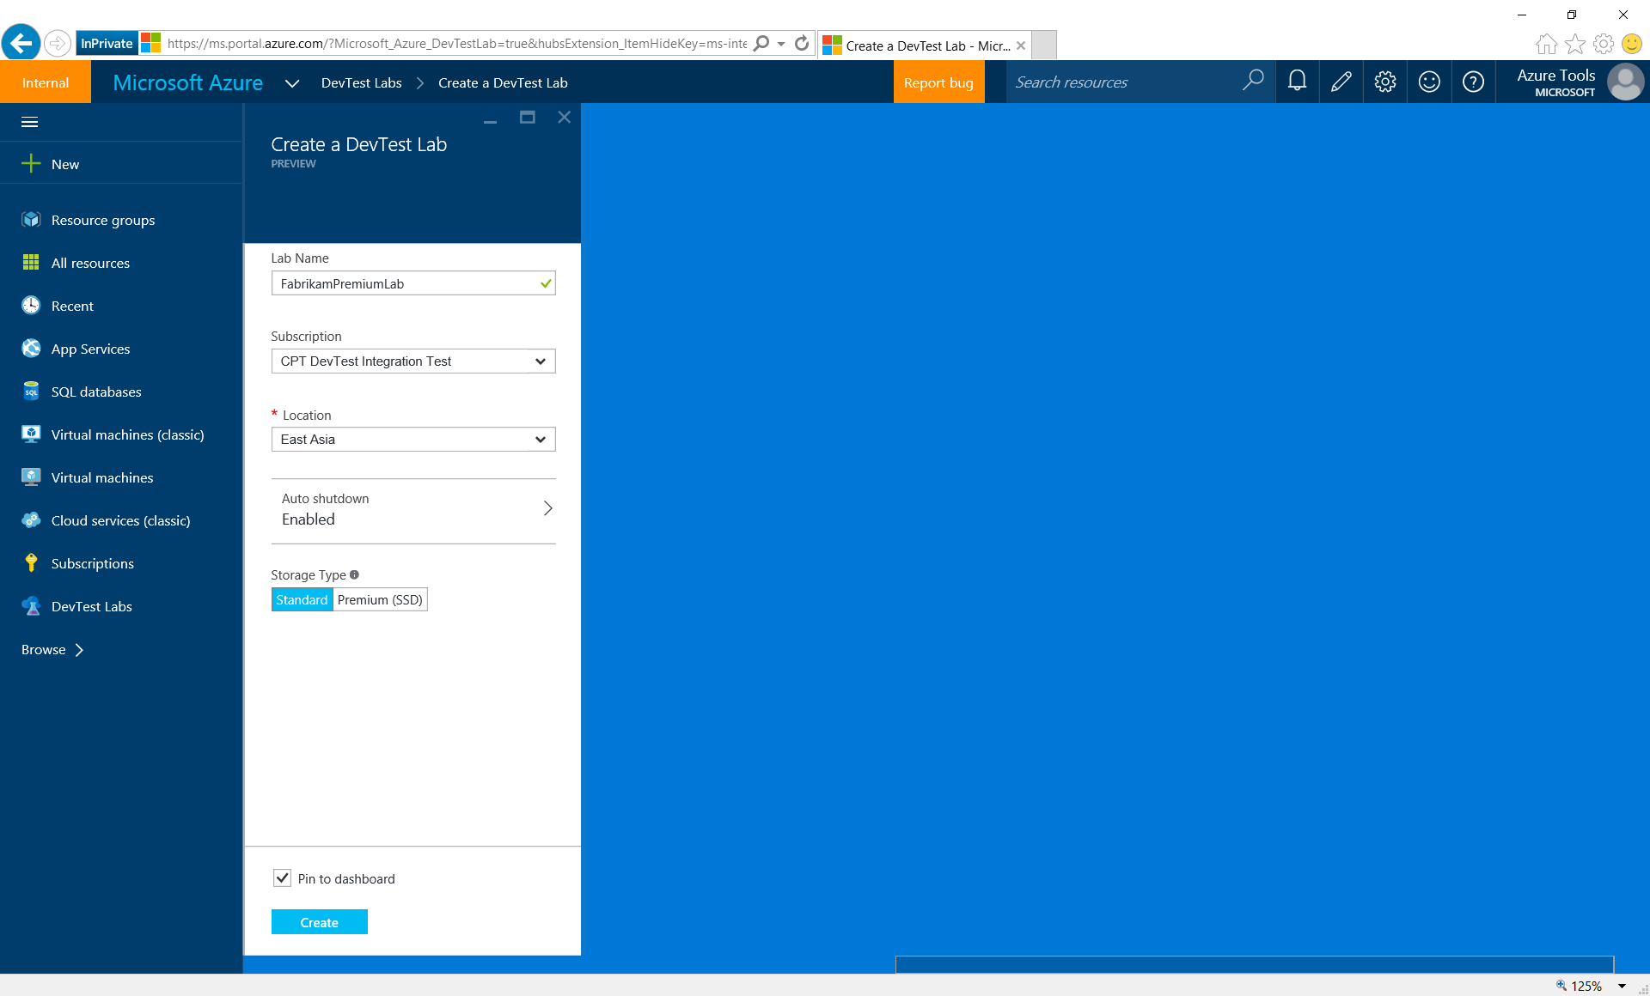
Notes:
Fill in the basic info…

Slide 22
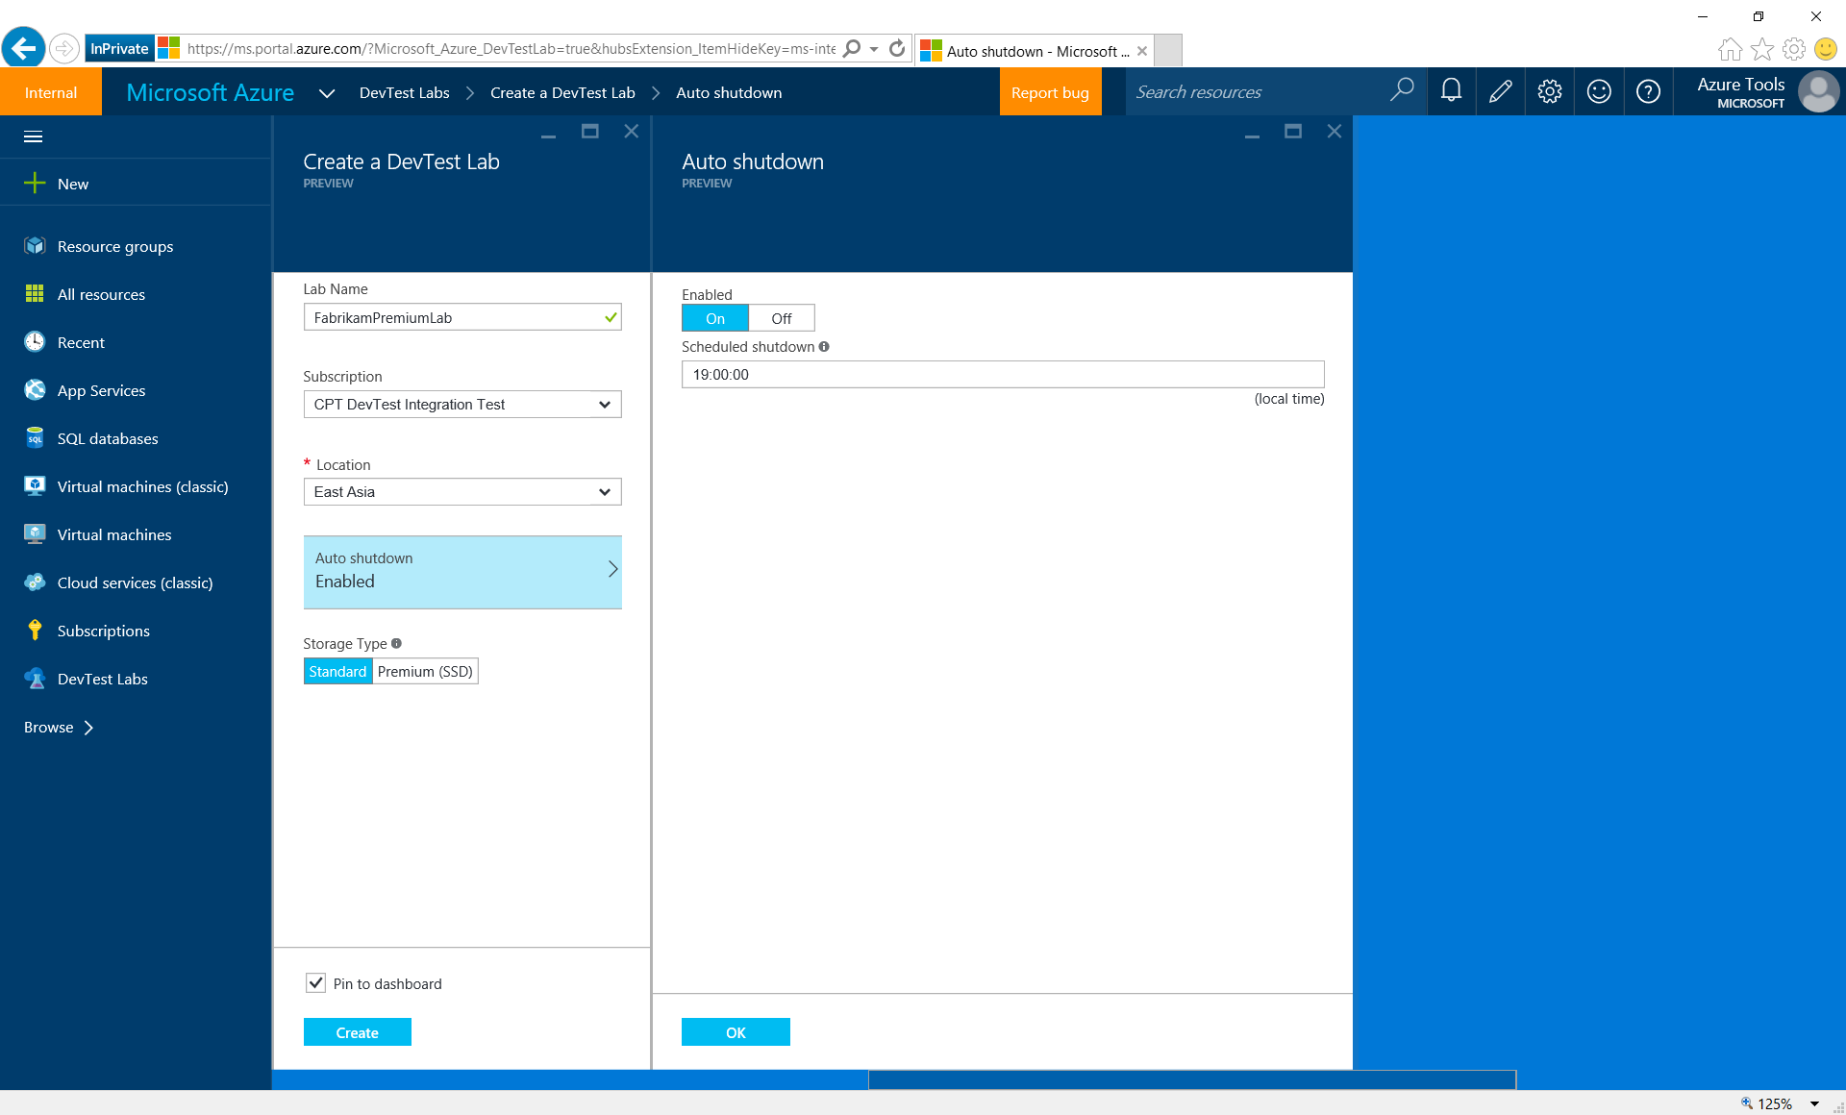
Notes:
By default, auto-shutdown policy is on when creating a lab, but can be updated.

Slide 23

Notes:
Labs can be created with either standard or premium storage. Premium storage gives VMs better performance, which is ideal for databases or powerful Dev machines. E.g. the normal reboot time for a Windows VM using premium storage can be just around 1 minutes.

Slide 24
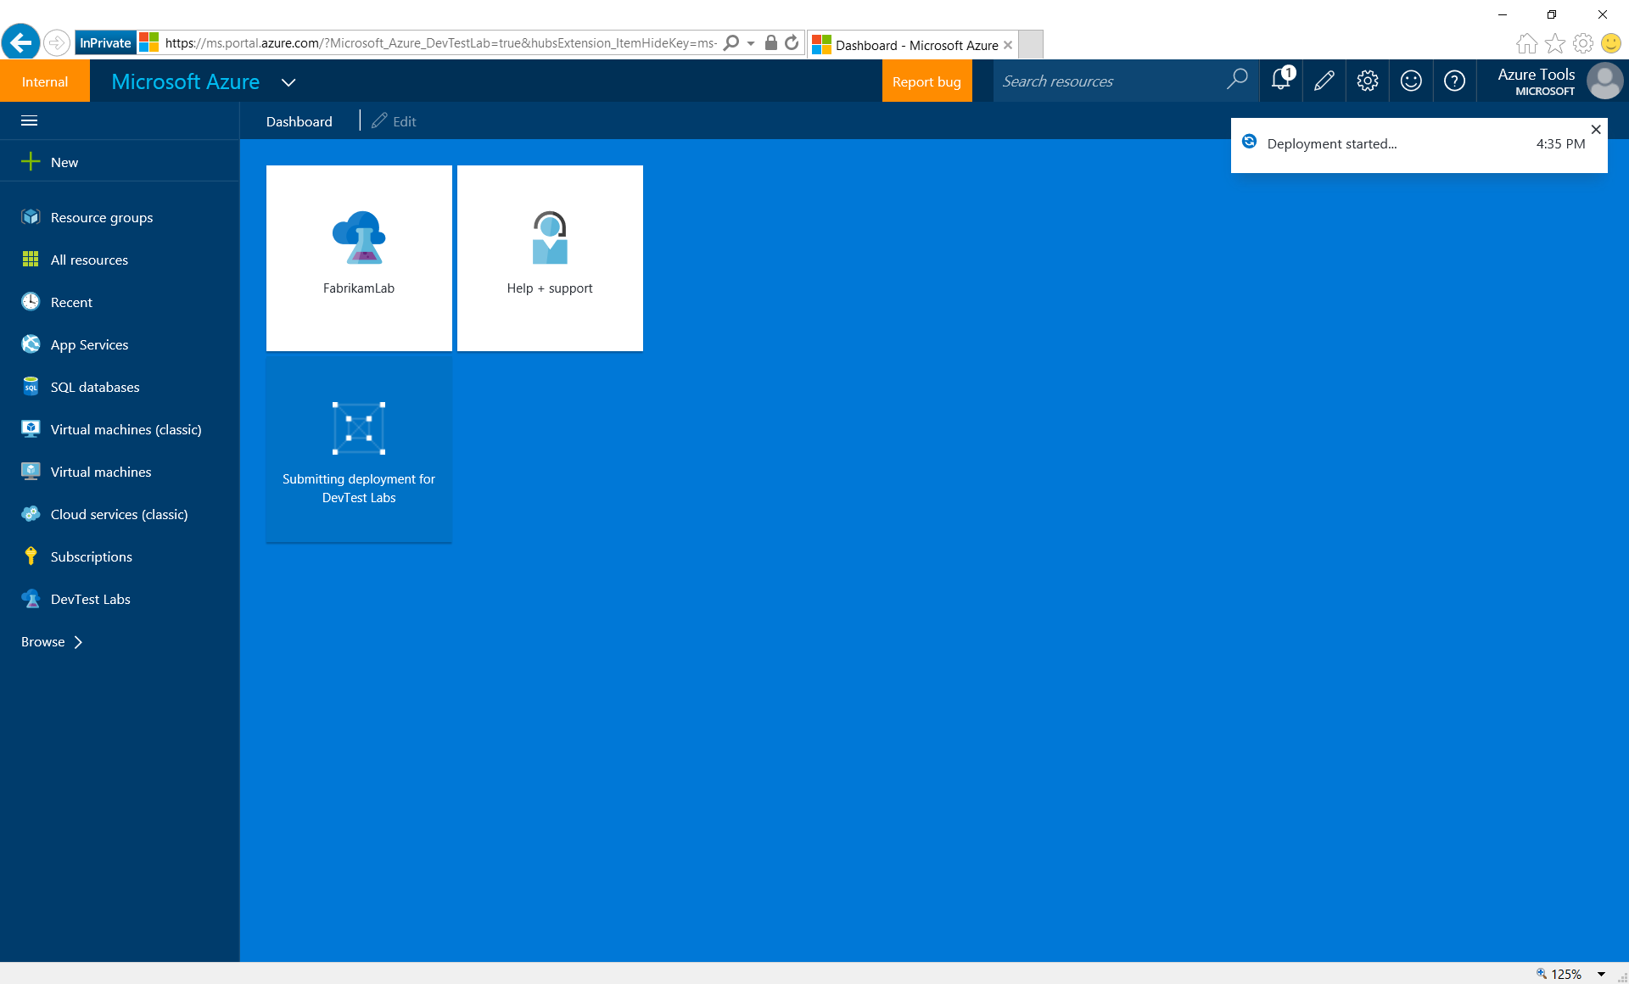
Notes:
Lab creation is in progress. A tile is auto-created at the Azure dashboard.

Slide 25
a couple of minutes later…

Slide 26
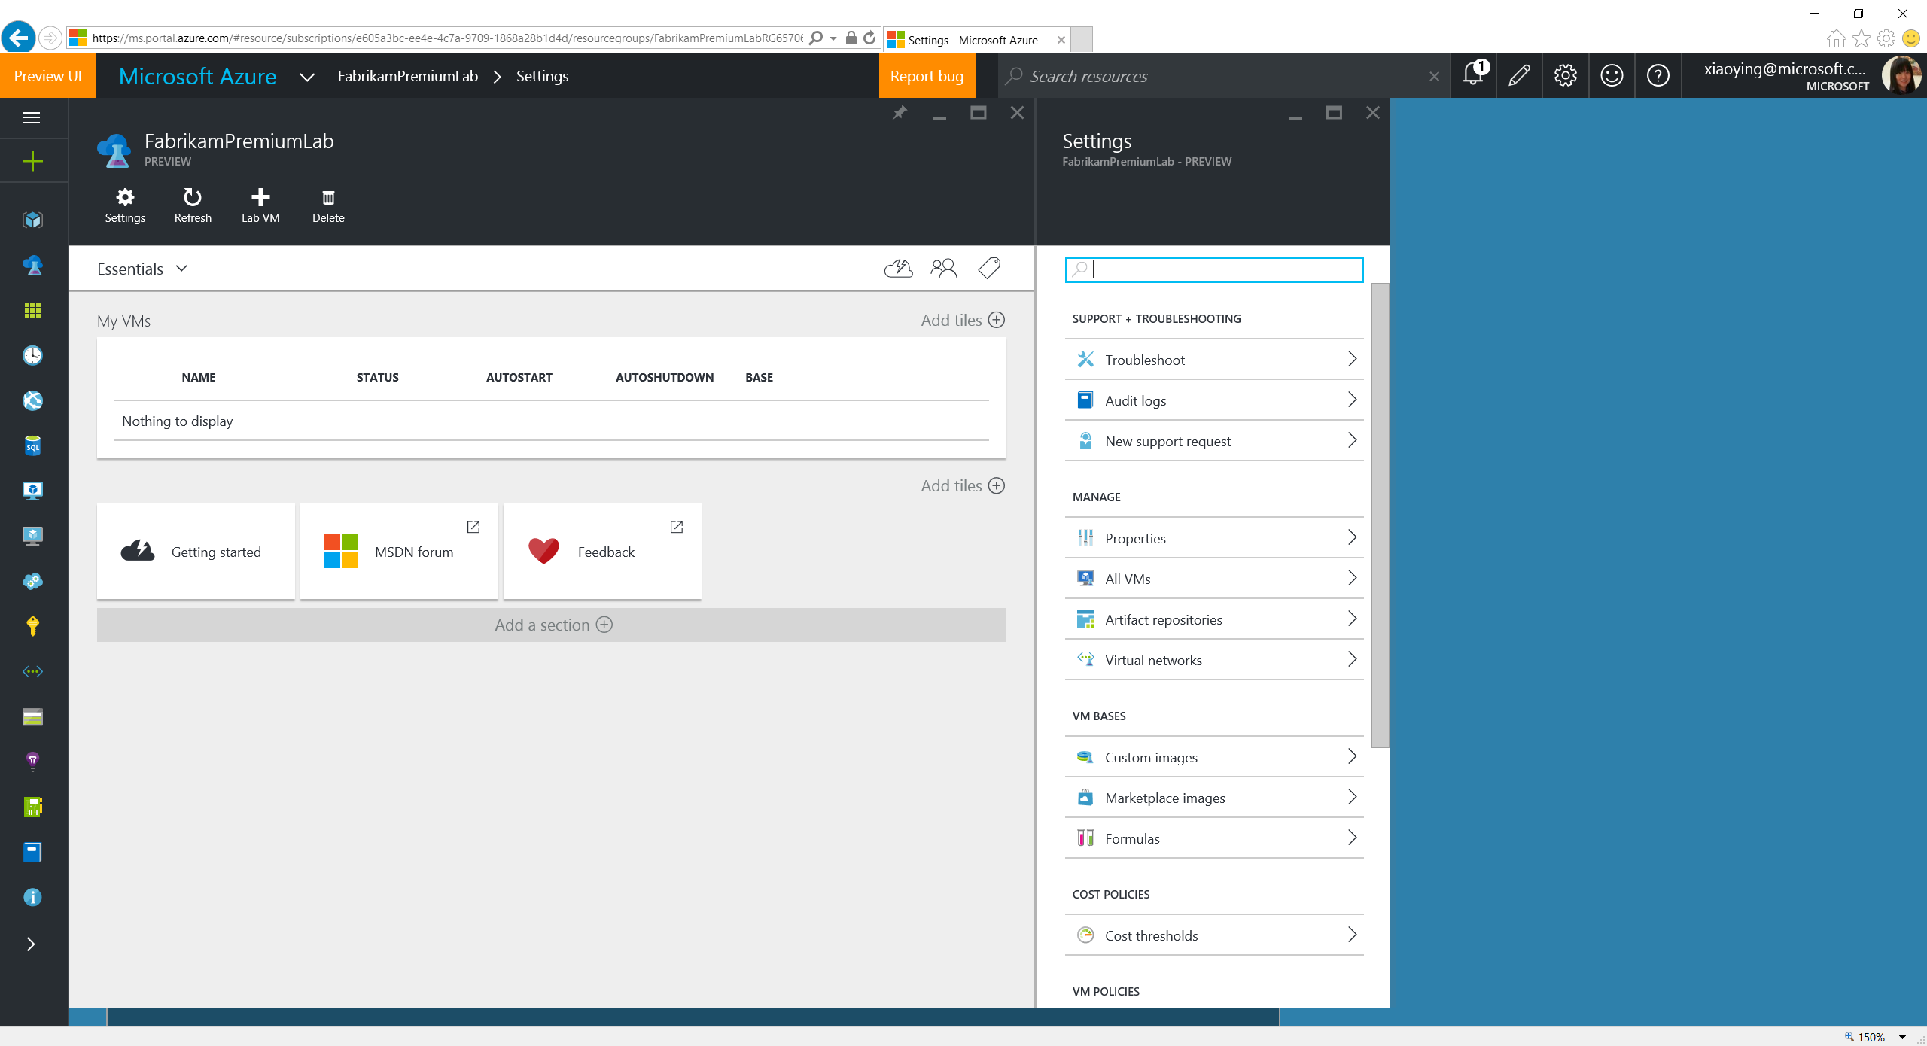
Notes:
In a couple of minutes, a new lab is created and ready to use.

Slide 27
Set Policies

Slide 28
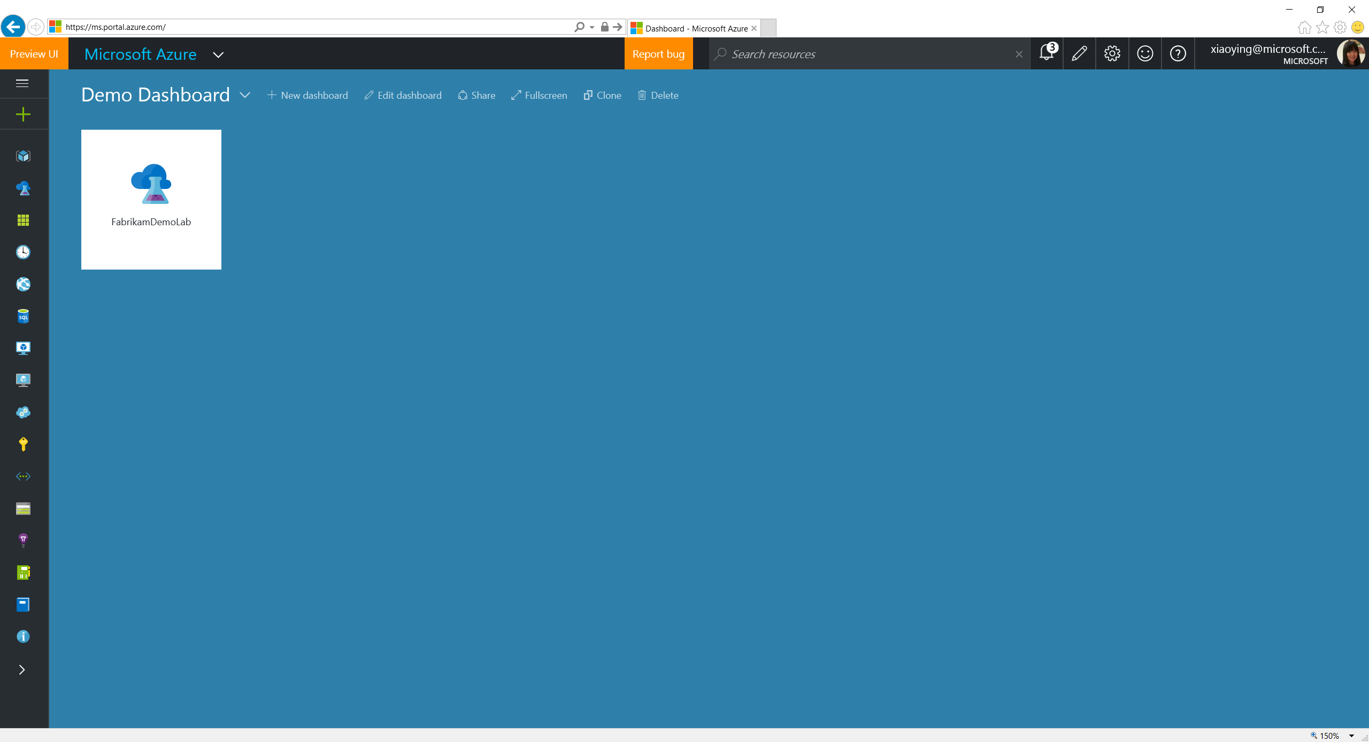
Notes:
Click a lab tile on the dashboard (if pinned) from the Azure dashboard (or select from the lab blade).

Slide 29
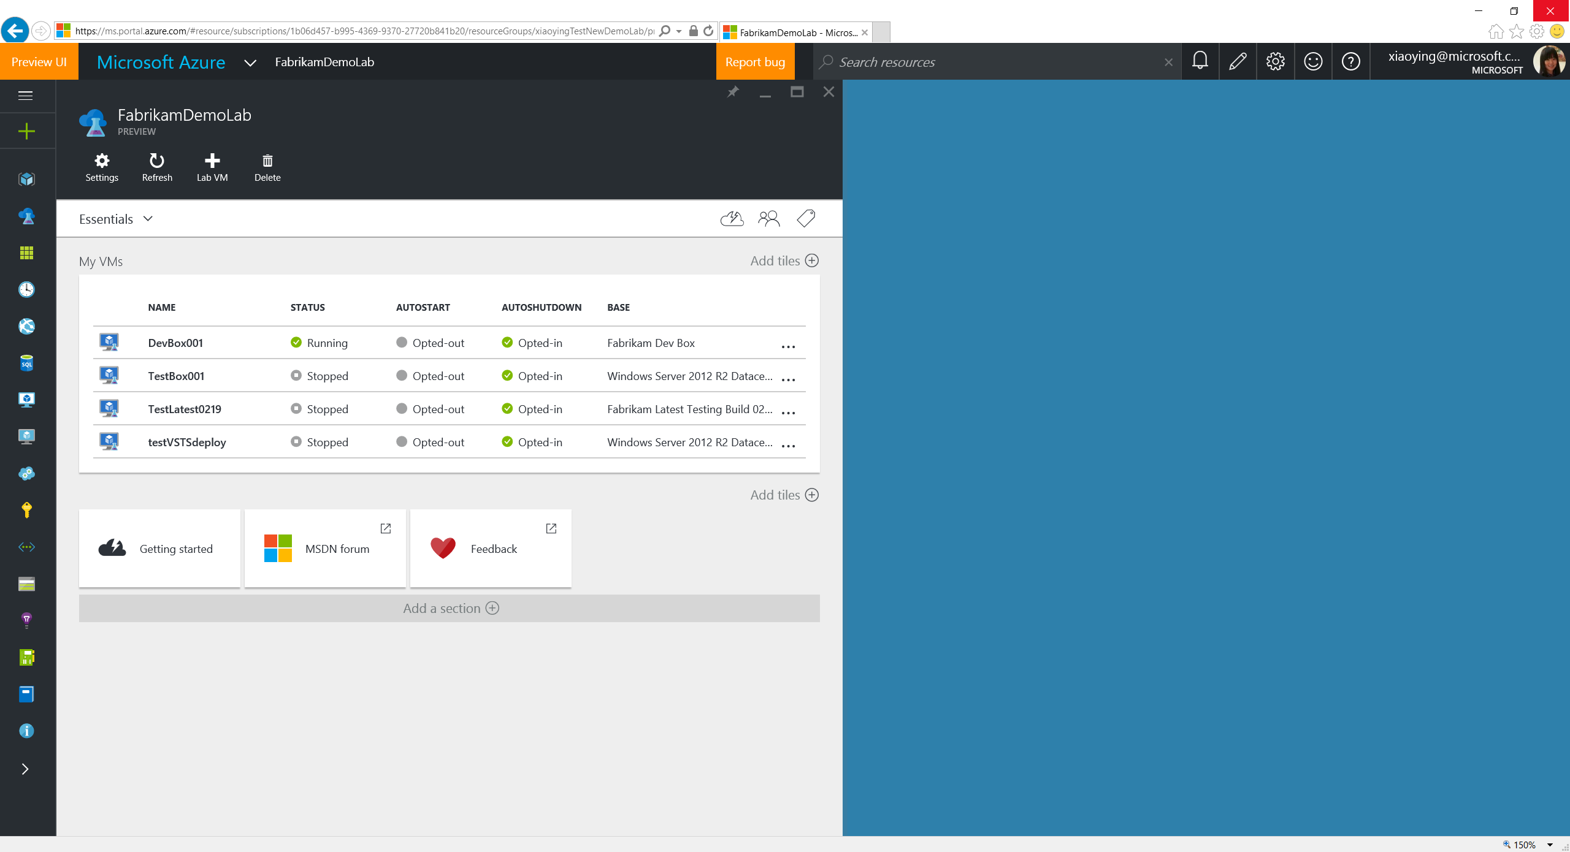
Notes:
Settings blade is opened automatically when opening a lab blade, which contains all the policy settings.

Slide 30
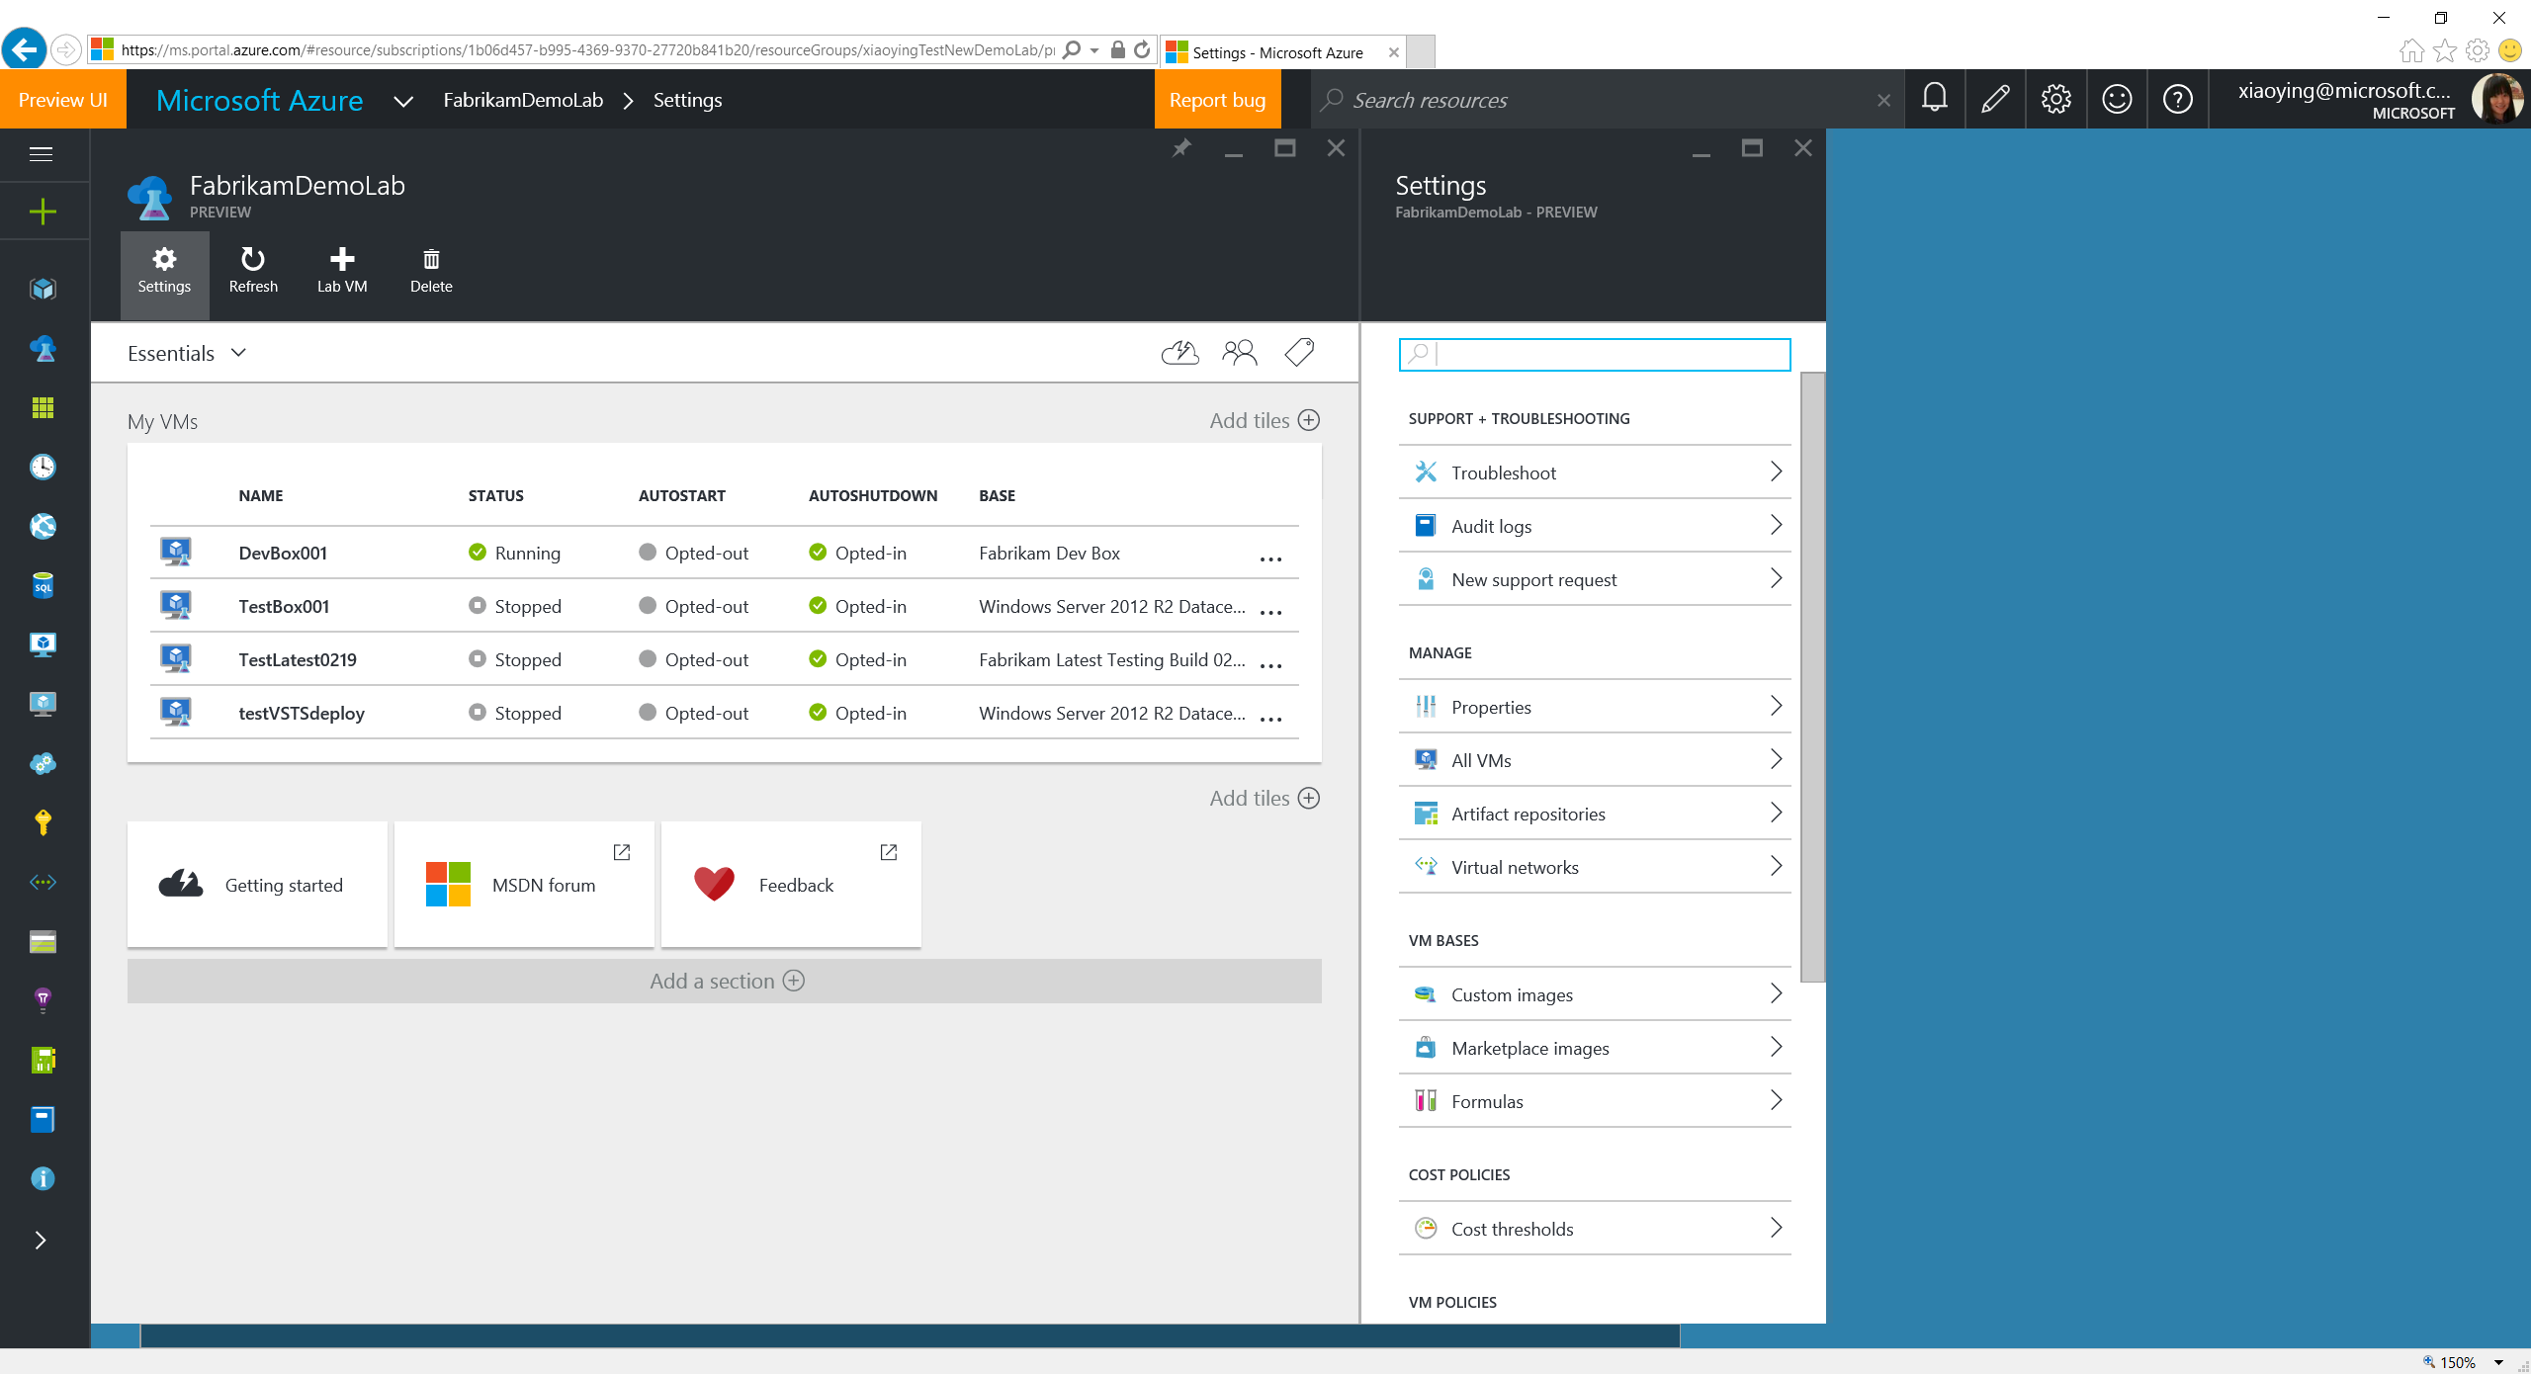

Slide 31
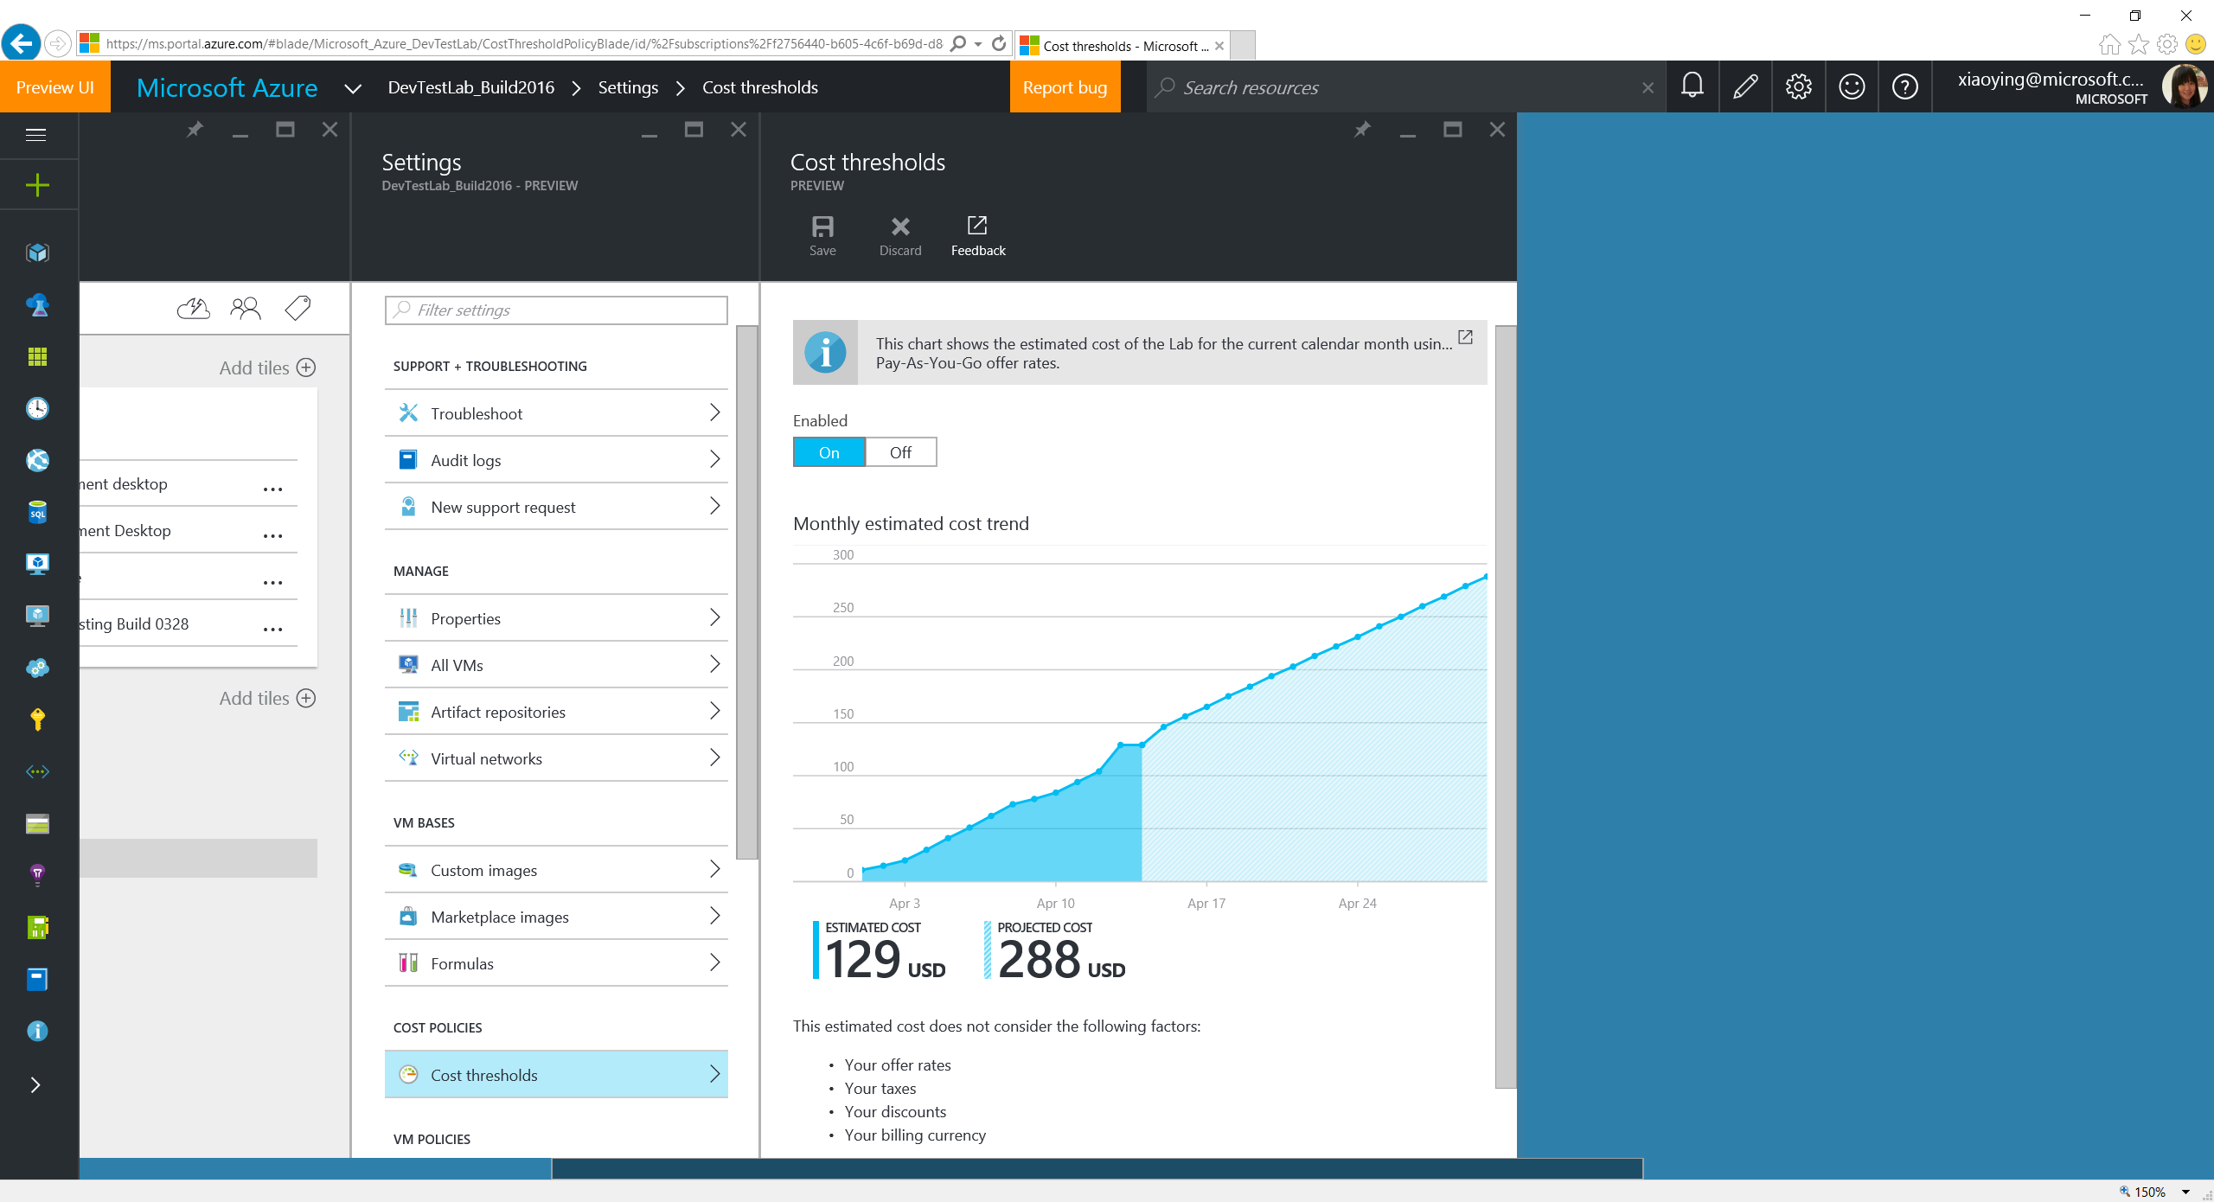
Notes:
As the 1st iteration, Cost Threshold shows the cost trending chart based on the resource usage in the lab, and offers a projection based on the current spending.

Slide 32
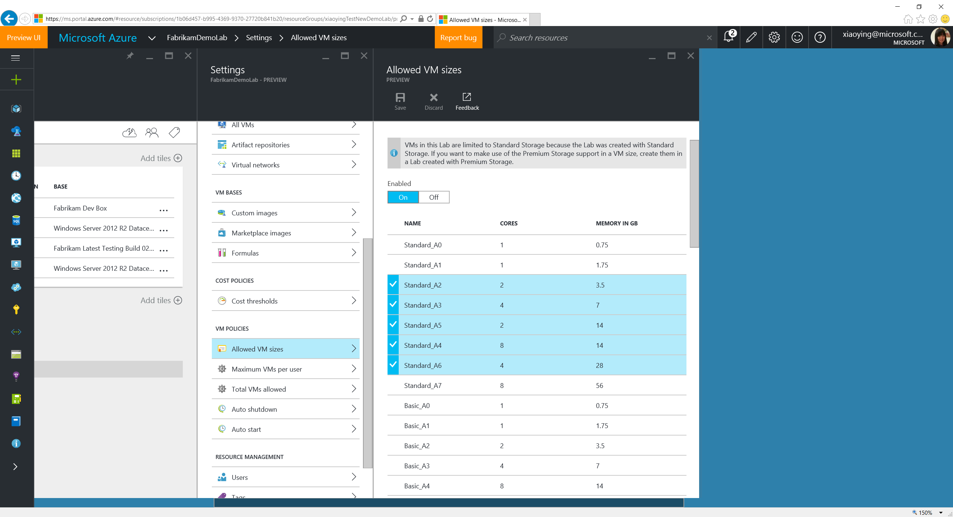
Notes:
Allowed VM Sizes allows to pick a list of VM sizes that lab users can choose when creating VMs in the lab.

Slide 33
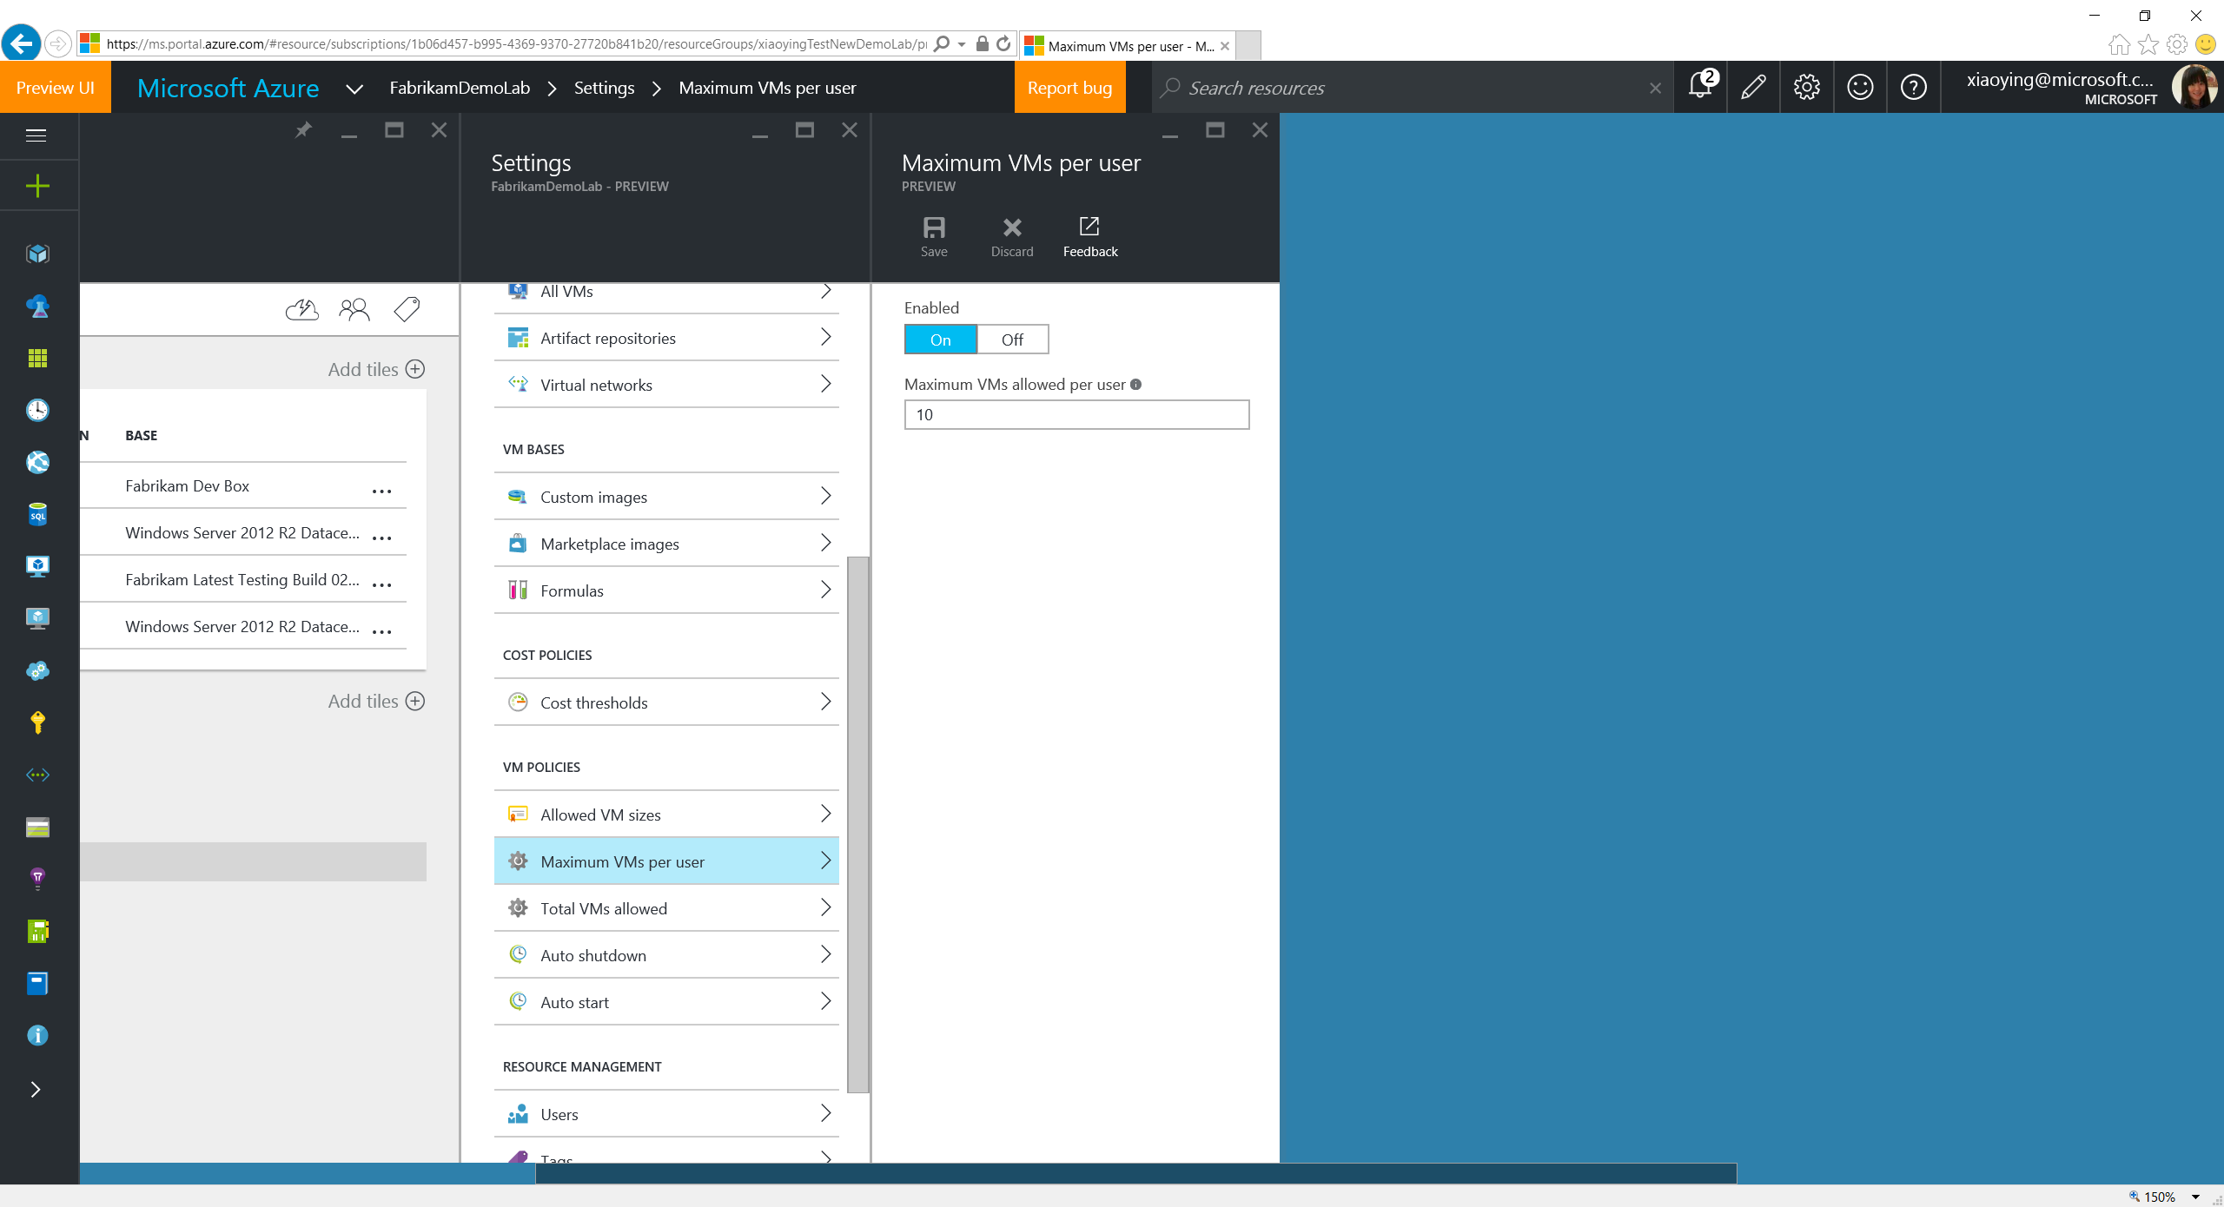
Notes:
Maximum VMs Per User allows to set a threshold on the # of VMs each lab users can create.

Slide 34
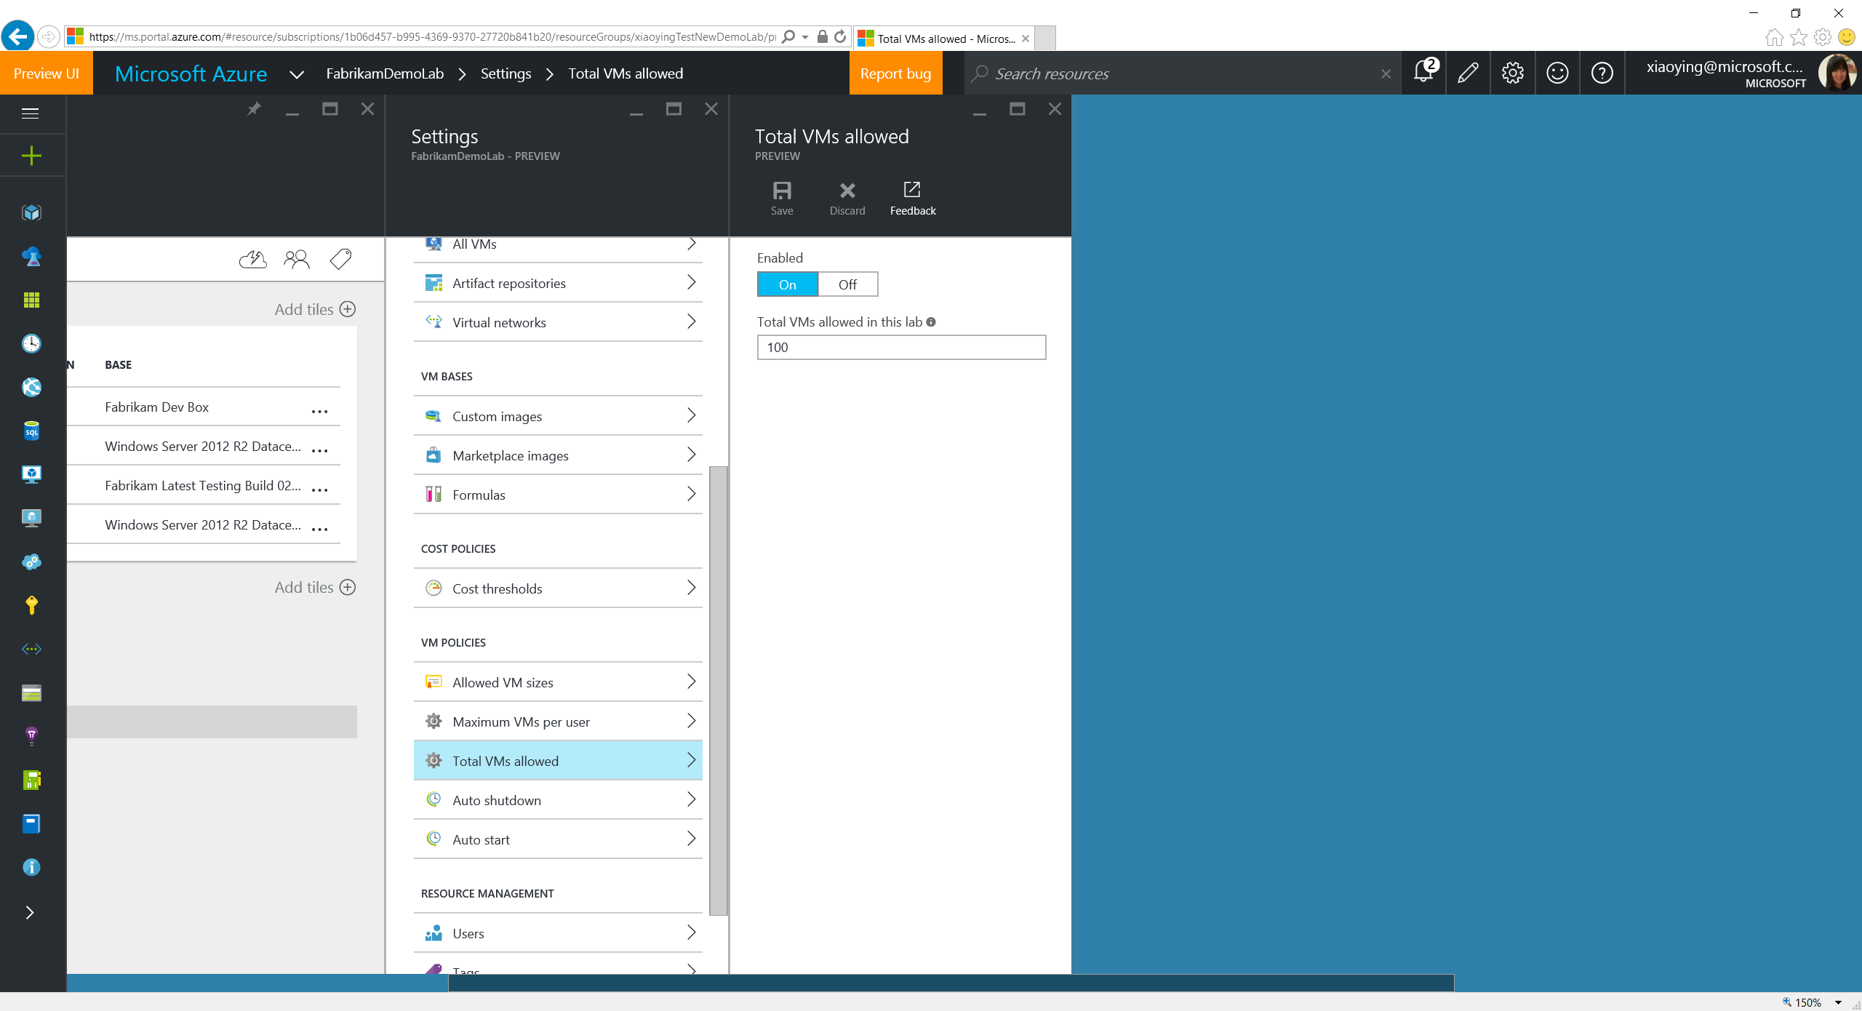
Notes:
Total VMs Allowed allows to set threshold on the total # of VMs that can be created within the lab.

Slide 35
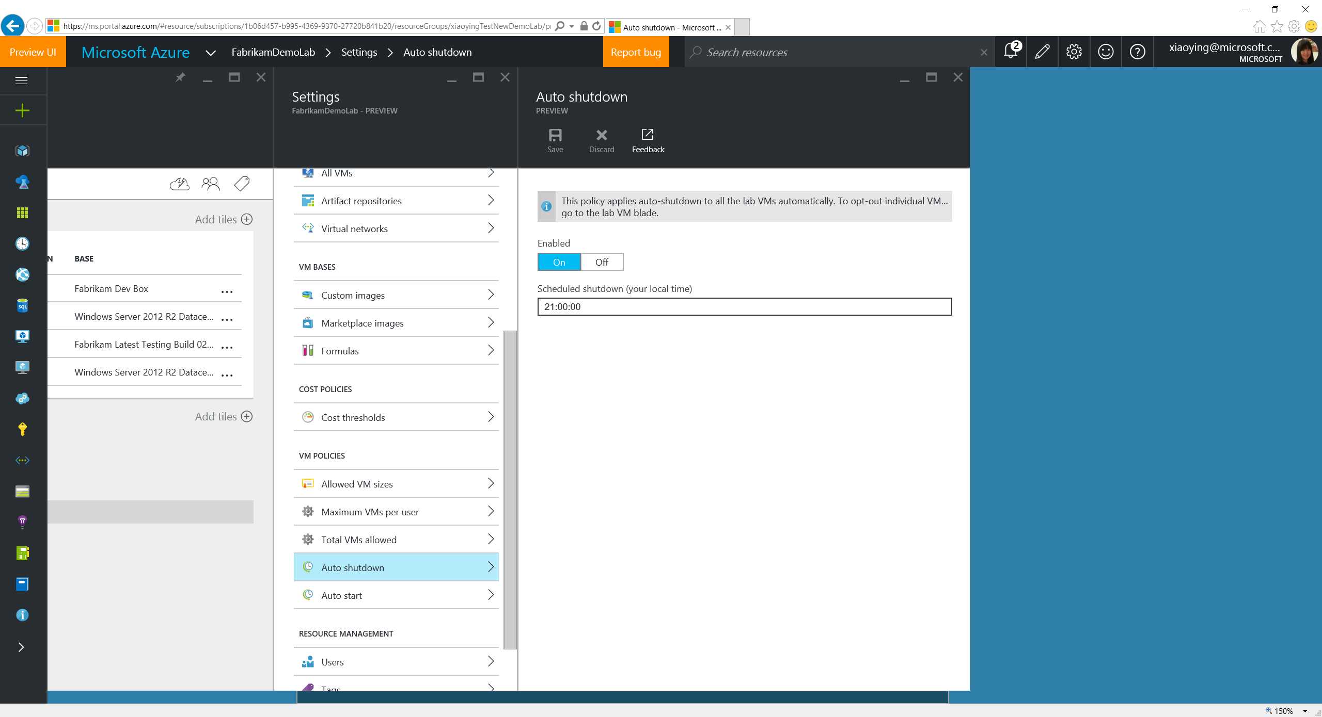
Notes:
Auto Shutdown allows to set a time when all the VMs in the lab (except opt-out ones) will be shutdown so as to reduce the spending.

Slide 36
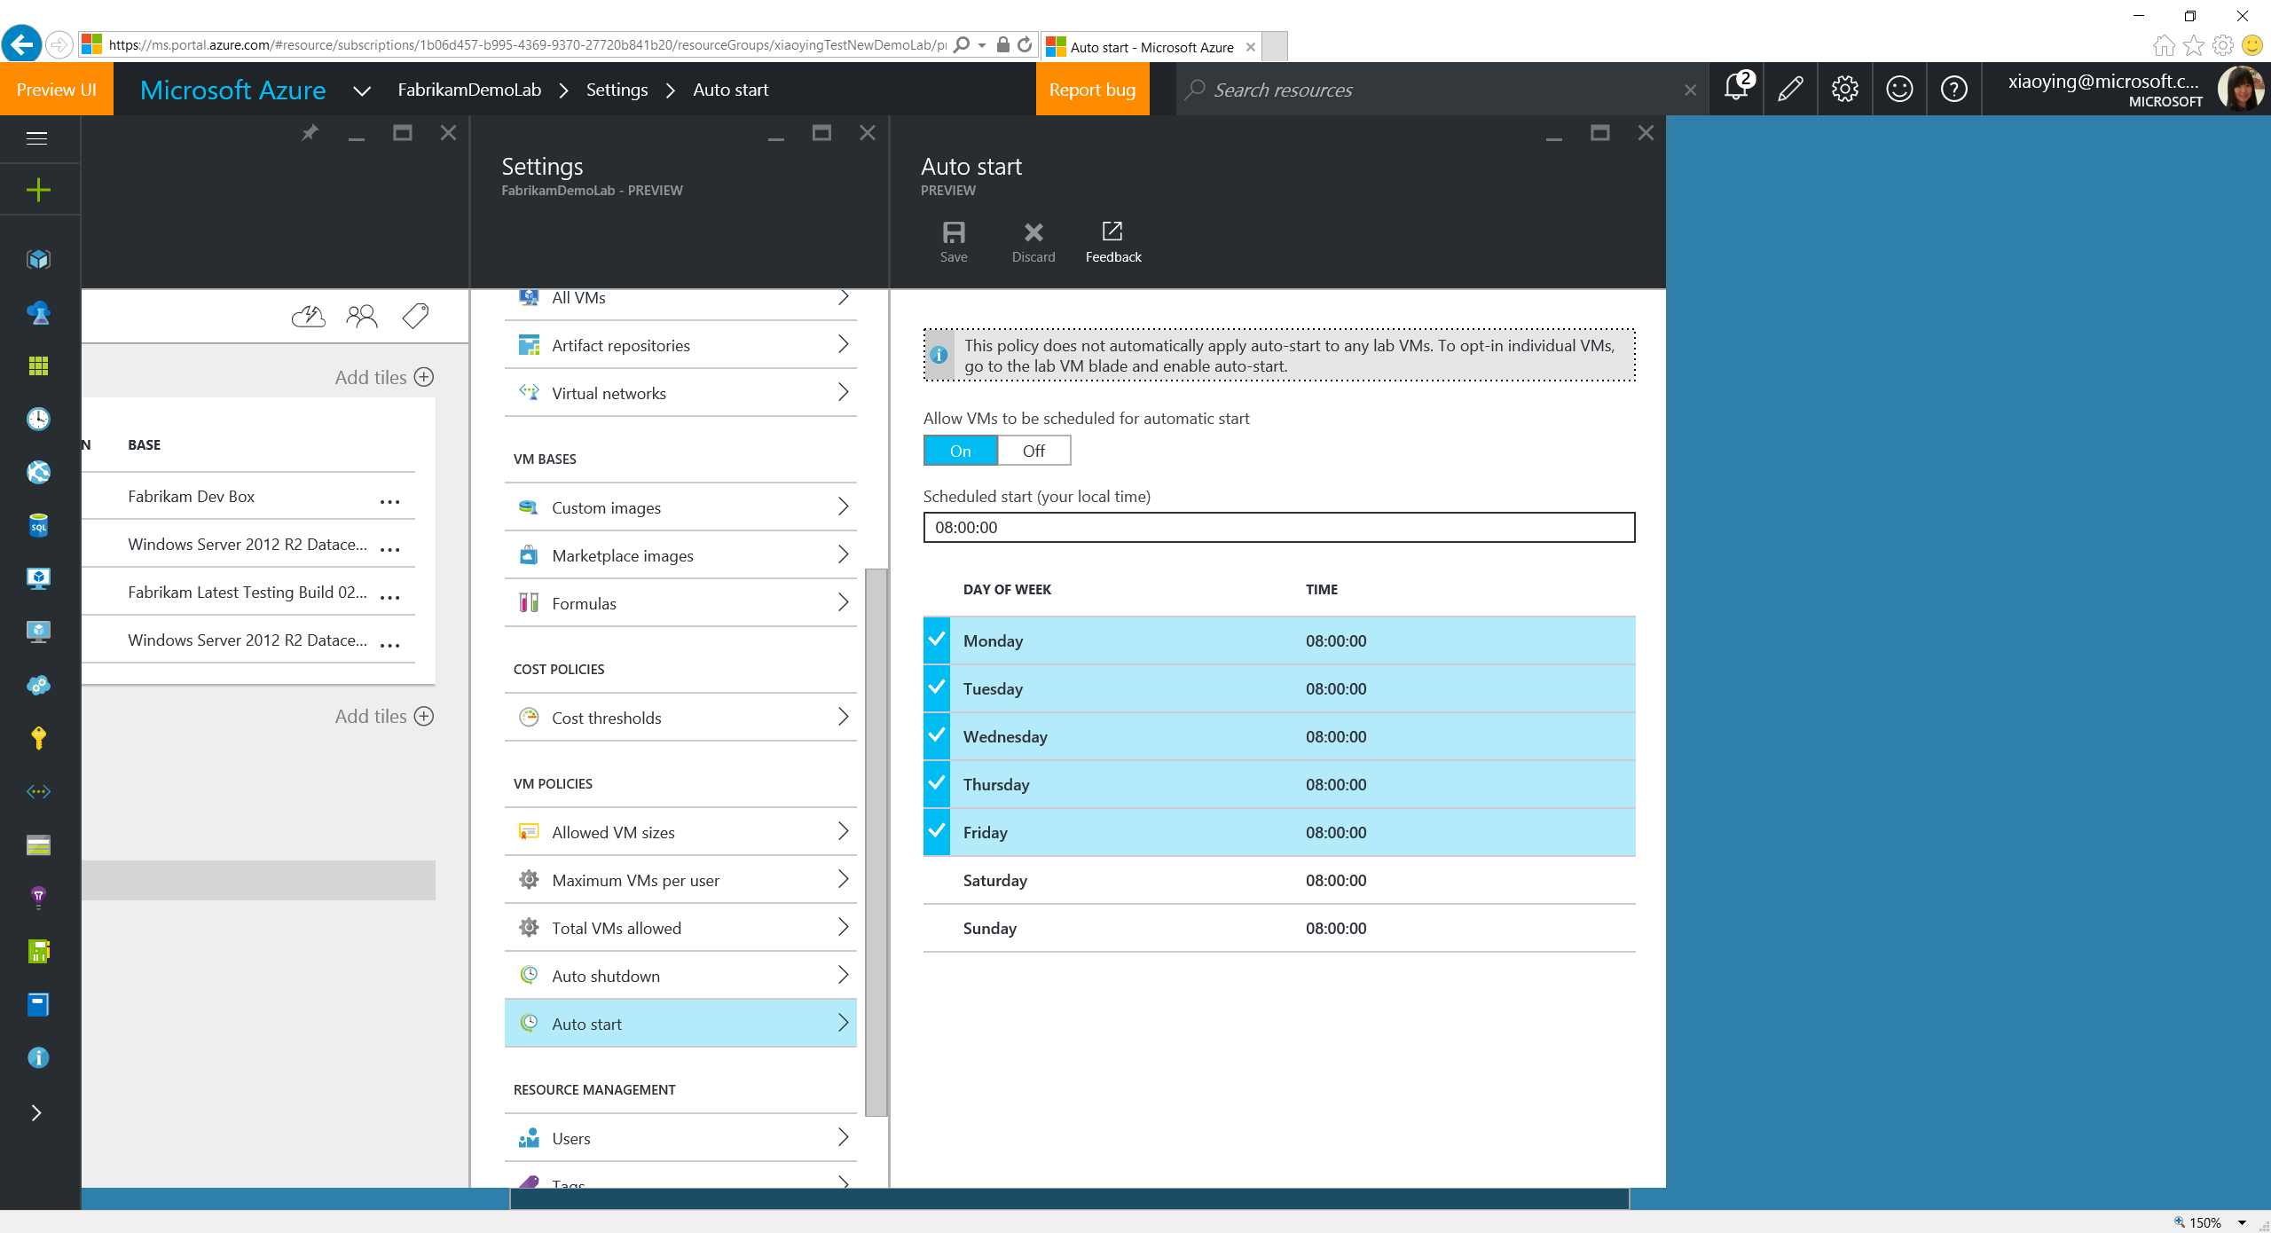
Notes:
Auto Start allows VMs in the lab to opt-in automatic start based on the specified time and the days. It allows the VMs to be ready for use automatically before the lab users start their work.

Slide 37
Set Virtual Networks

Slide 38
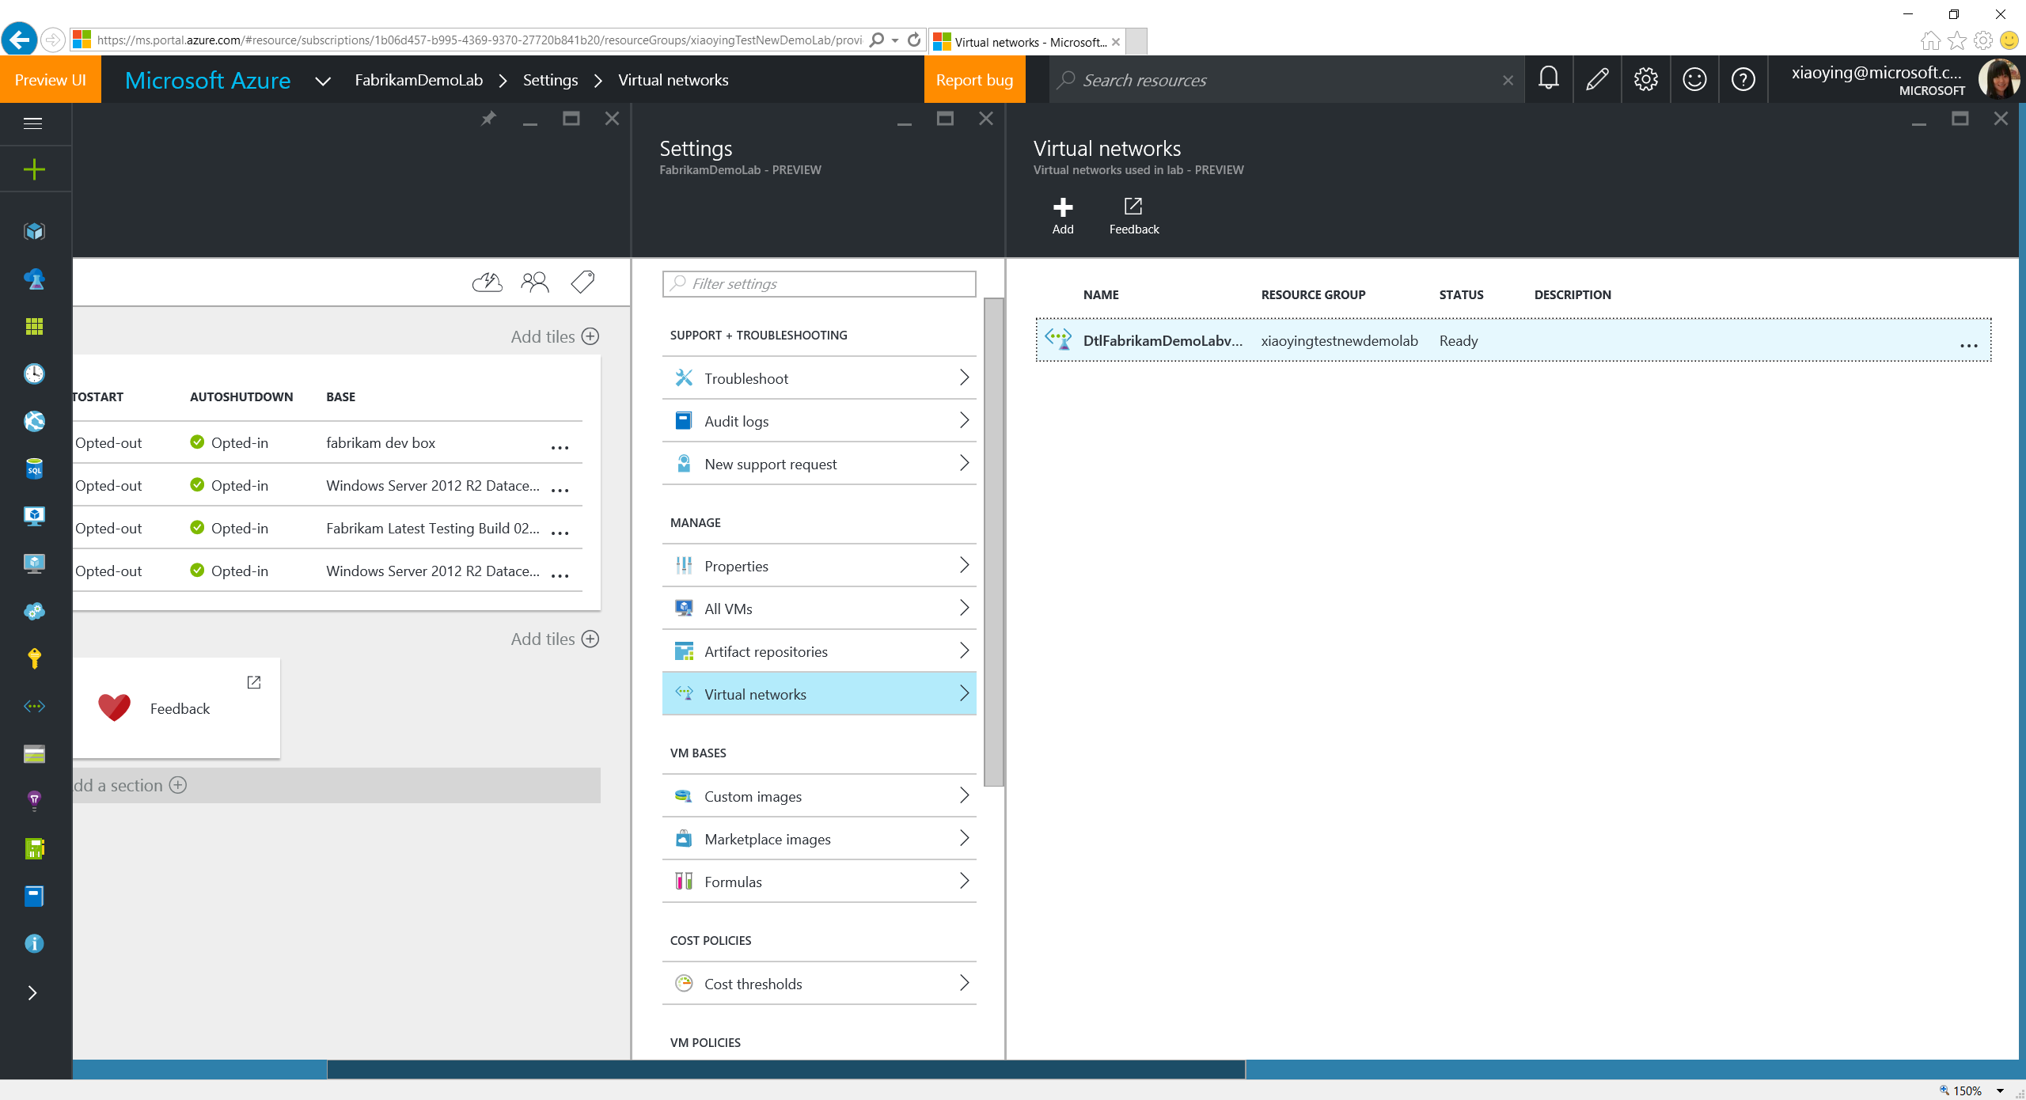

Slide 39
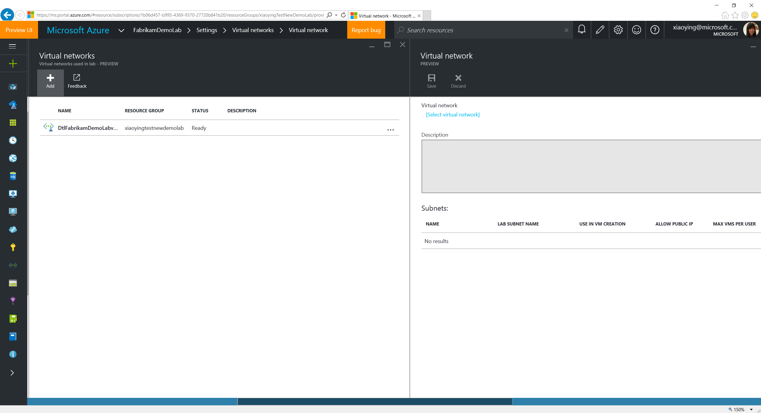
Notes:
Existing VNET in the subscription can be added into the lab for the lab users to use when they create a lab VM.

Slide 40
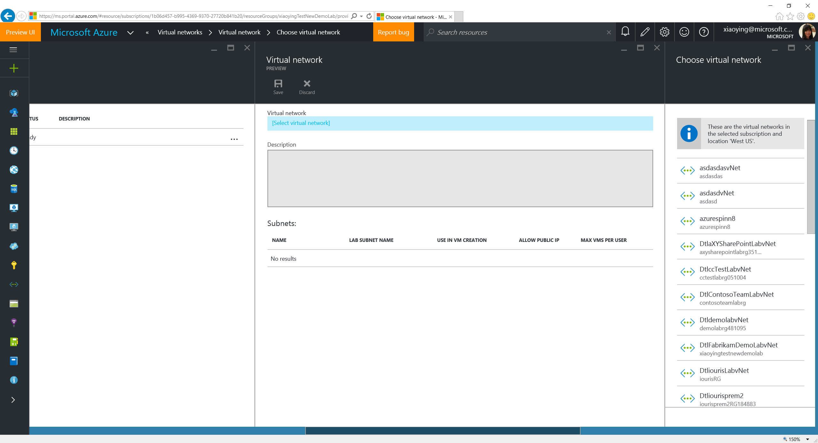
Notes:
Qualified VNET in the subscription can be added into the lab as long as it meets the following criteria:
In the same subscription.
In the same region.
The lab owner has the permission to access the VNET.

Slide 41
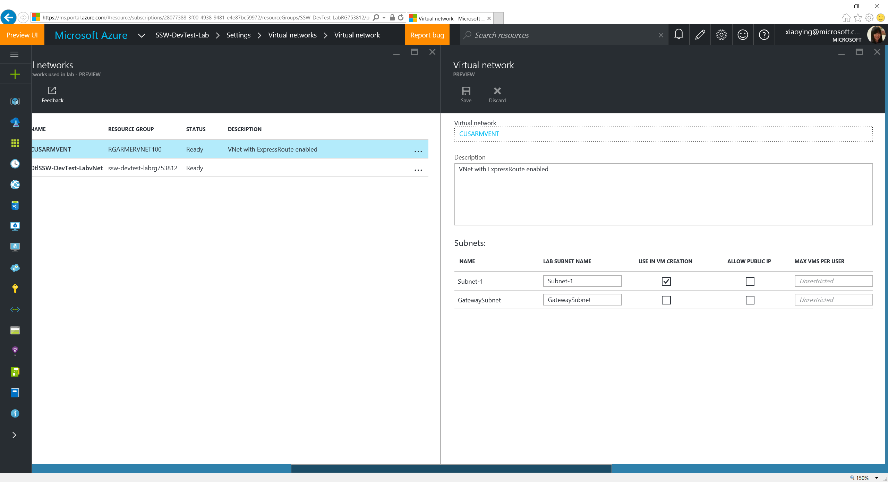
Notes:
Lab owner can define rules how the subnets in the VNET to be used, including whether it’s allowed for lab users to use when creating a VM, whether a public IP address is allowed to be added, and the maximum number of VMs allowed for each user in the subnet.

Slide 42
Configure Artifact Repositories

Slide 43
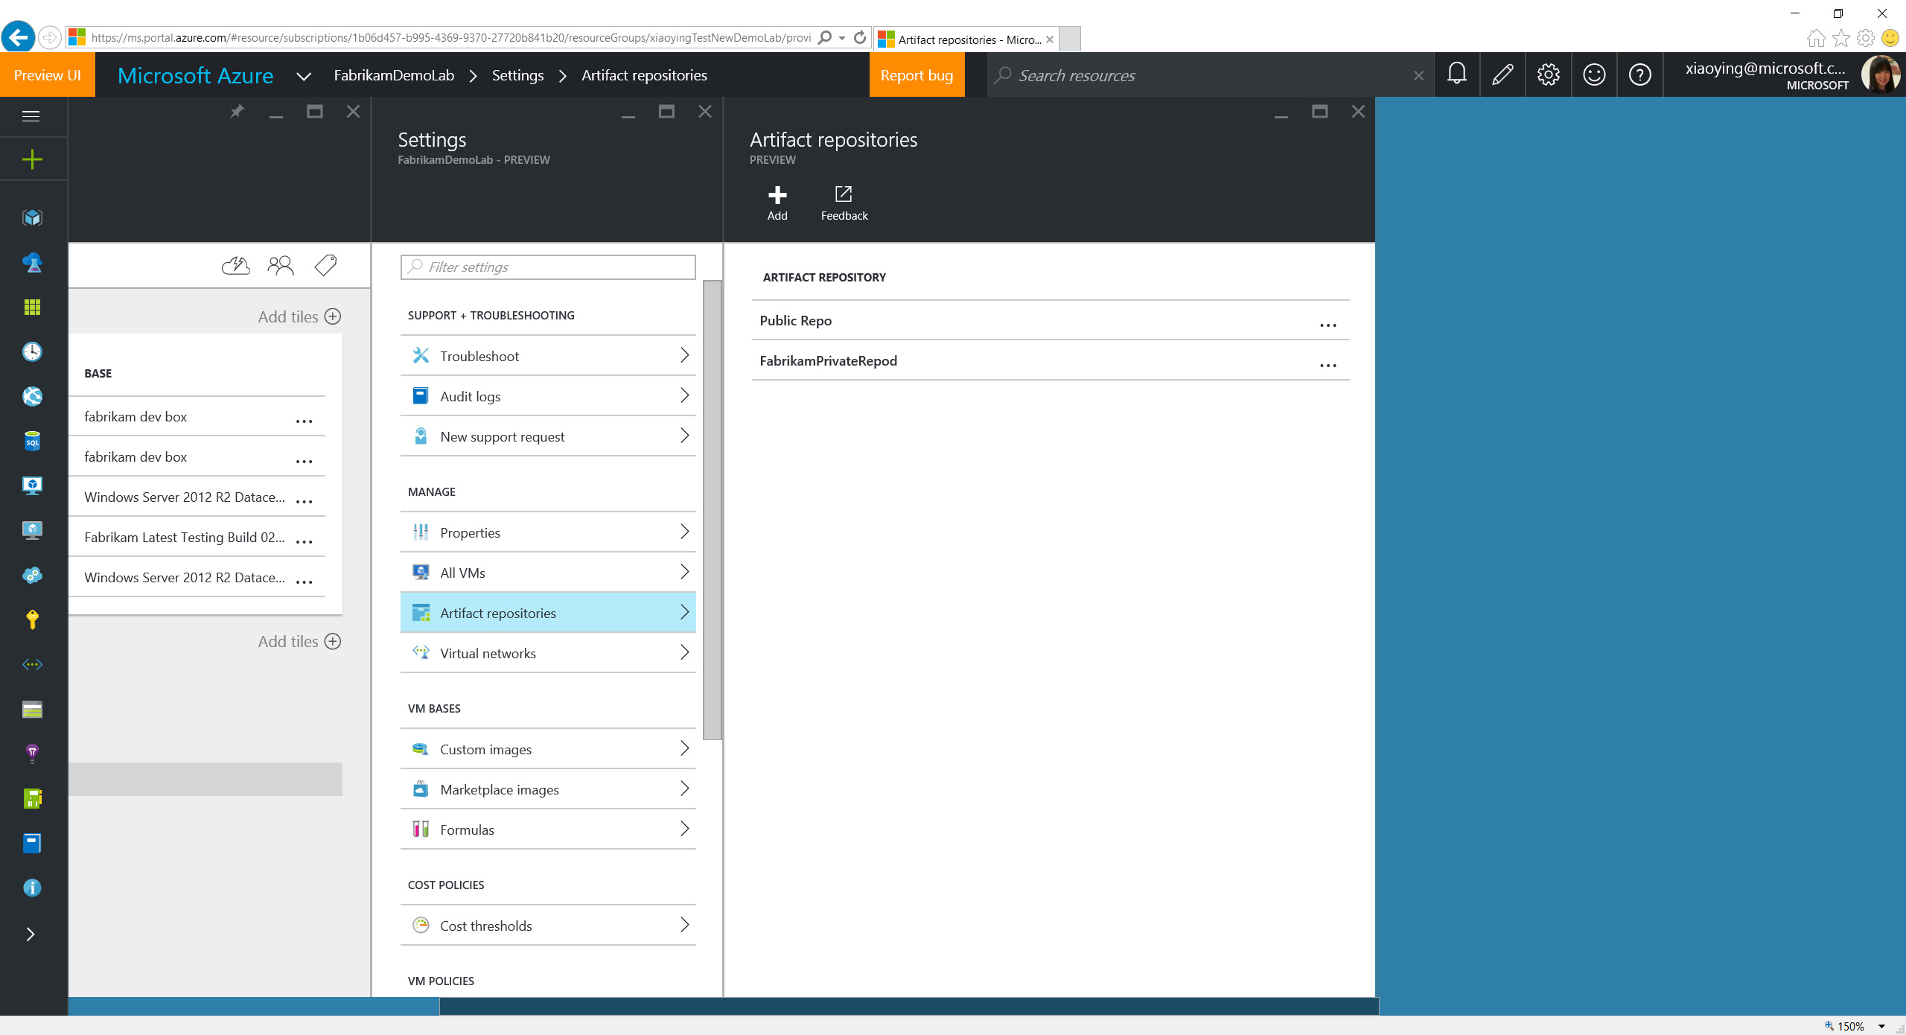
Notes:
At VM creation, Labs loads artifact files (which is defined in JSON format) from Git repos. It comes with a public GitHub repo, but private repo can also be added to feed more custom artifacts.

Slide 44
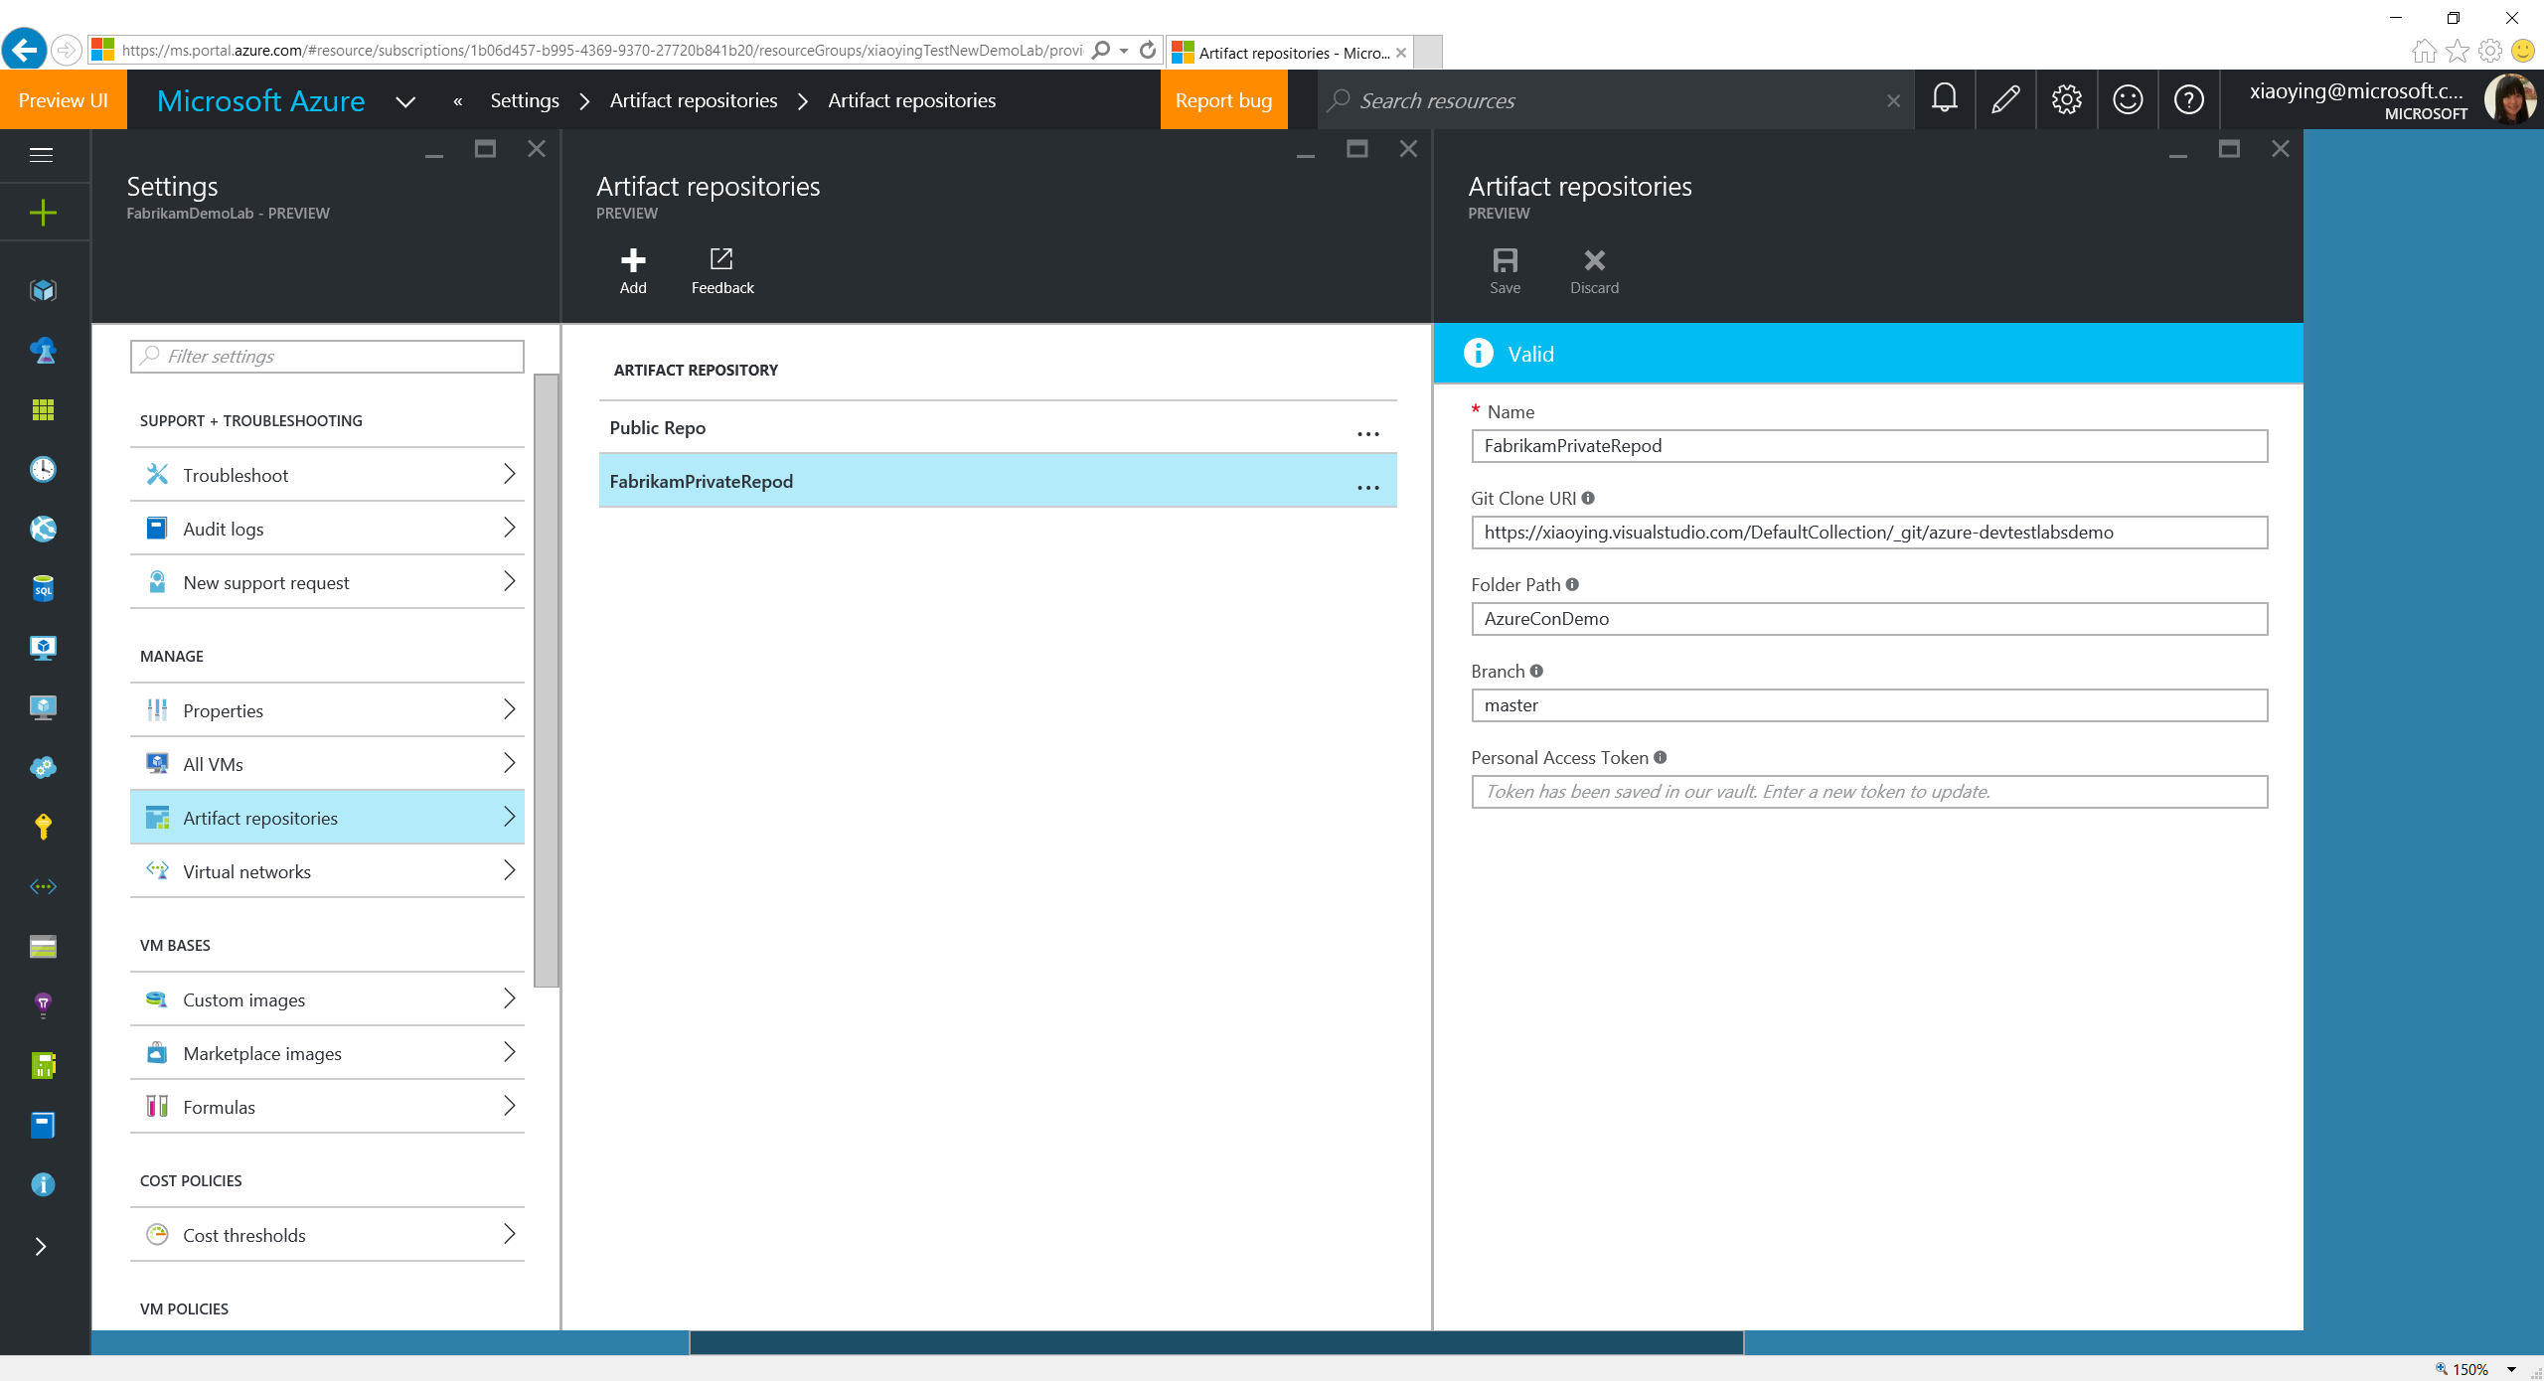
Notes:
Private repos can be added or updated through the lab Settings.

Slide 45
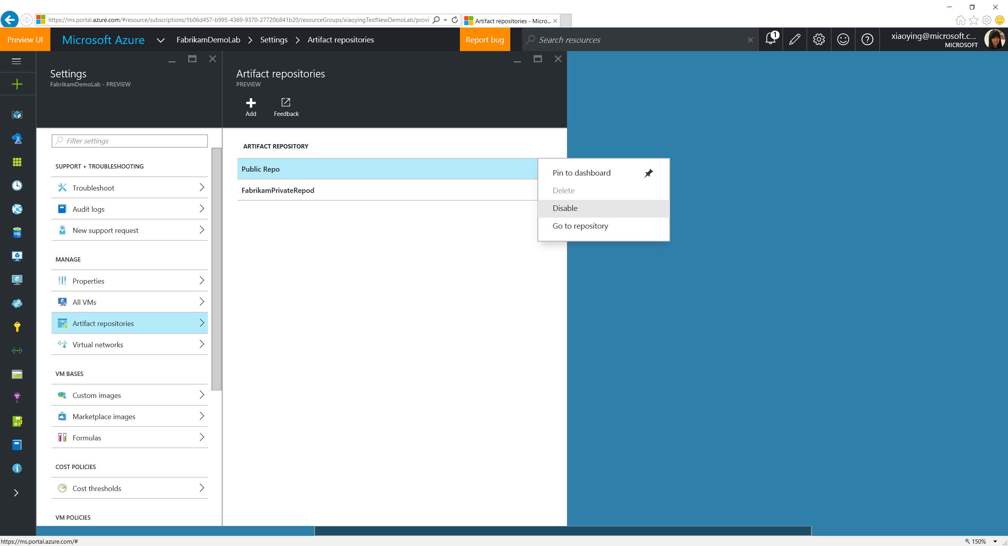
Notes:
If your compliance policy doesn’t allow any artifacts in Labs’ public repo, the Public Repo can be disabled through Settings. When it happens, a recommendation for better productivity is to browse the existing artifacts in the public repo, and copy that ones you need into the private repo and tweak them in a way that follows the compliance. You can also temporarily disable a private repo before it’s ready for lab users to use.

Slide 46
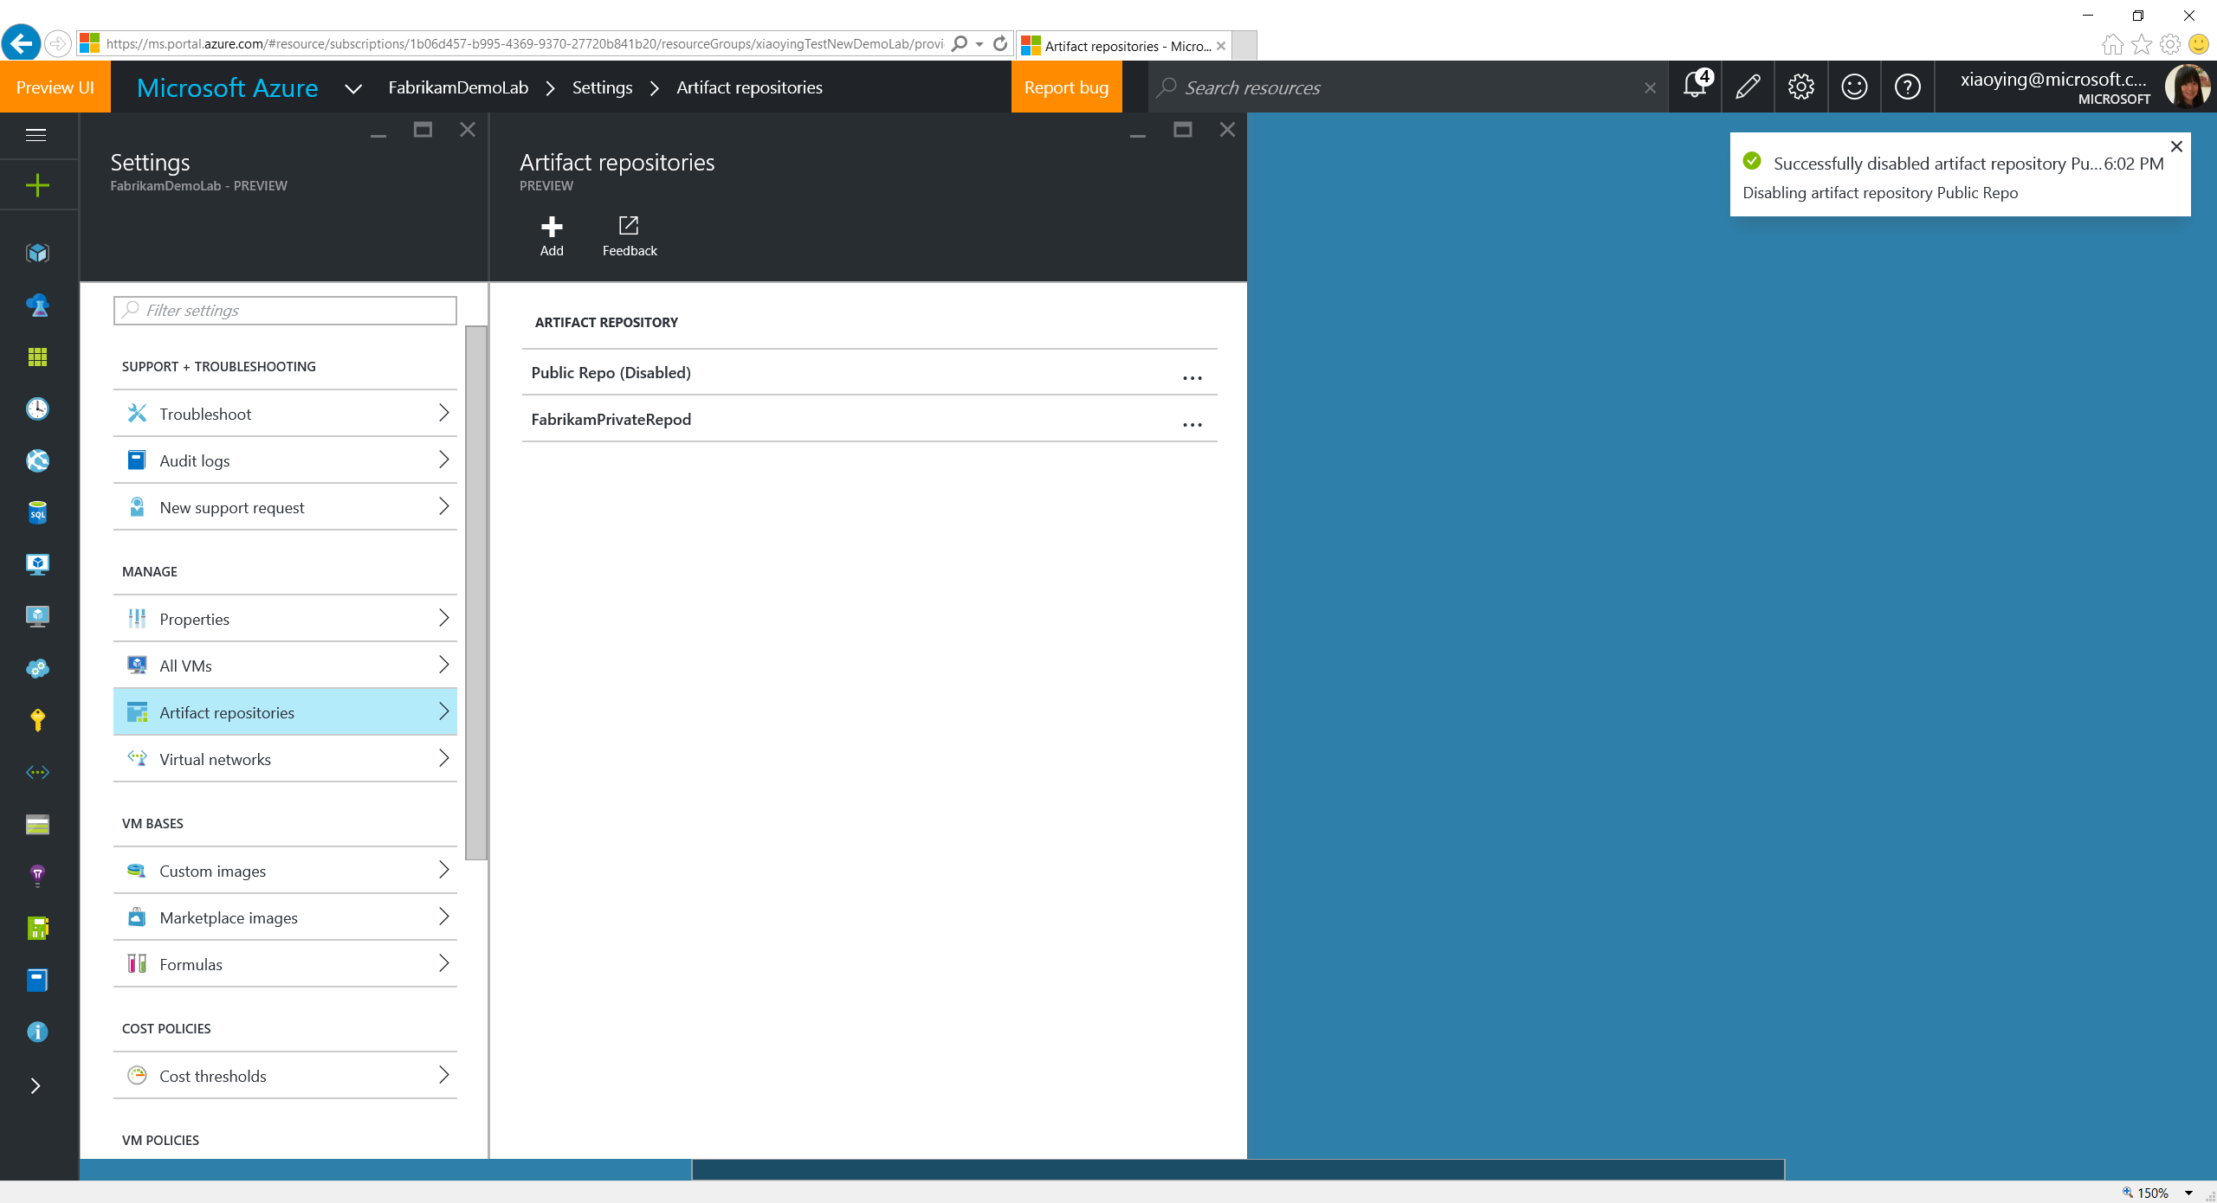
Notes:
The public repo is disabled.

Slide 47
Manage VM Bases

Slide 48
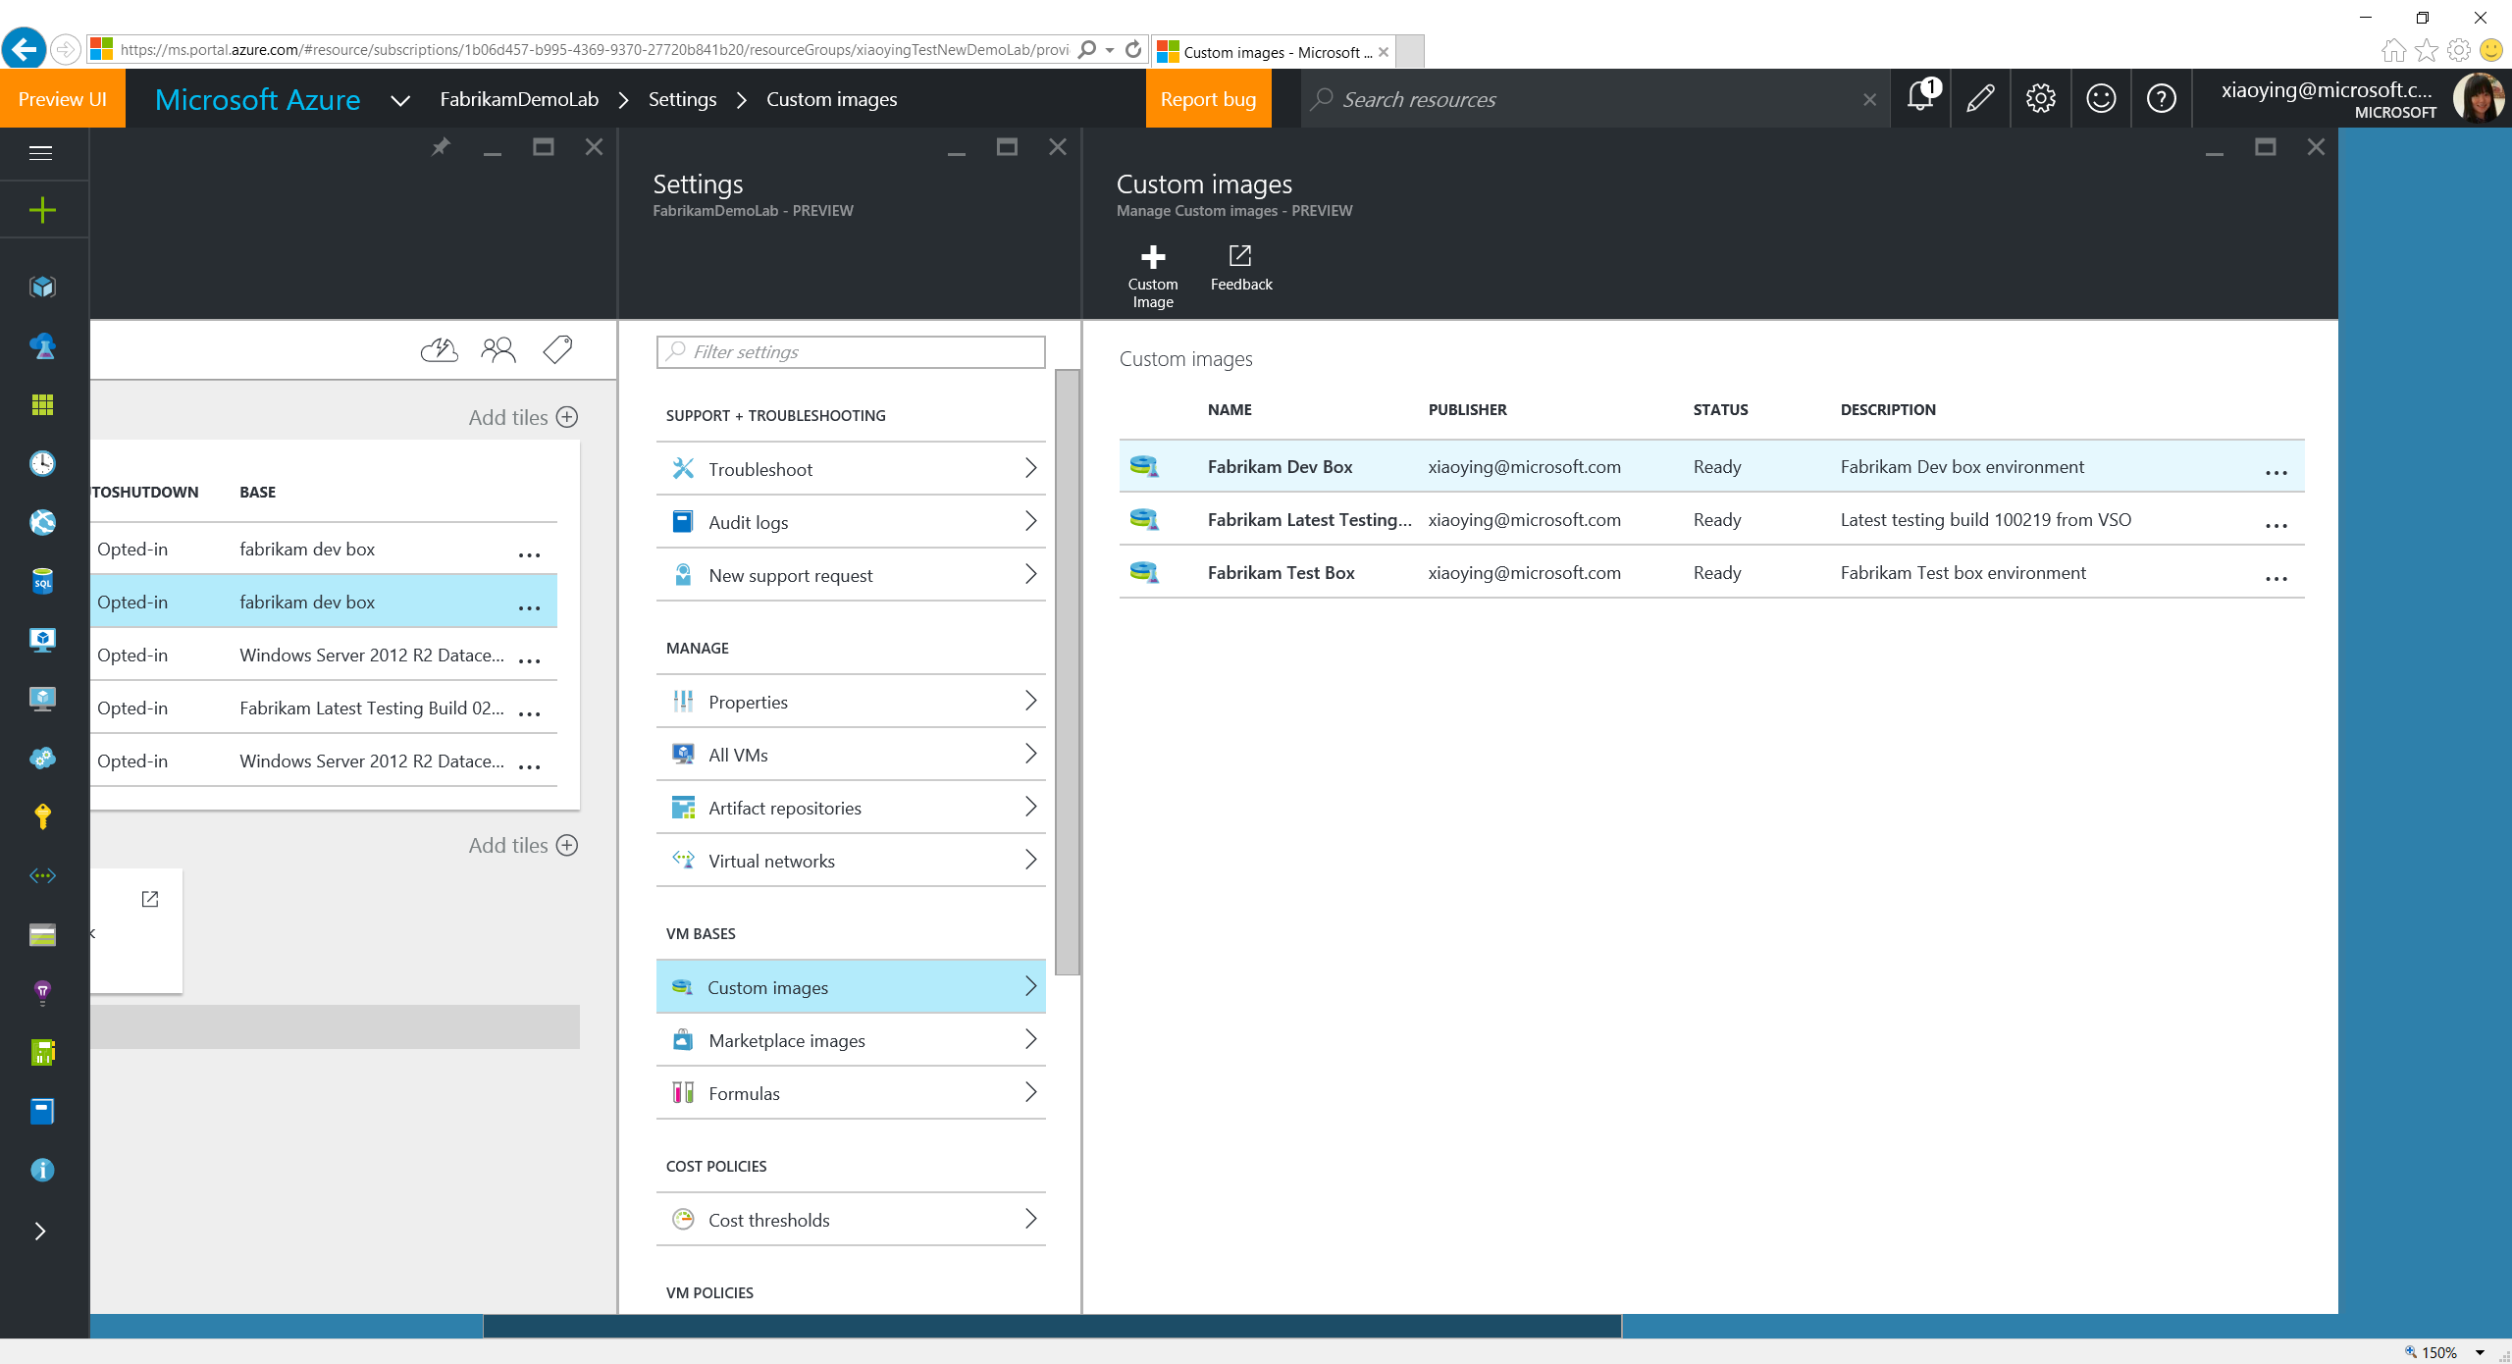
Notes:
VM Bases are used when creating a VM, including formulas, custom images and Azure Marketplace images. Formula is a template with pre-defined values to the lab VM creation settings. Custom images are from the VHDs added into the lab. Lab owner can whitelist Azure Marketplace images allowed to show up in the lab VM base.

Slide 49
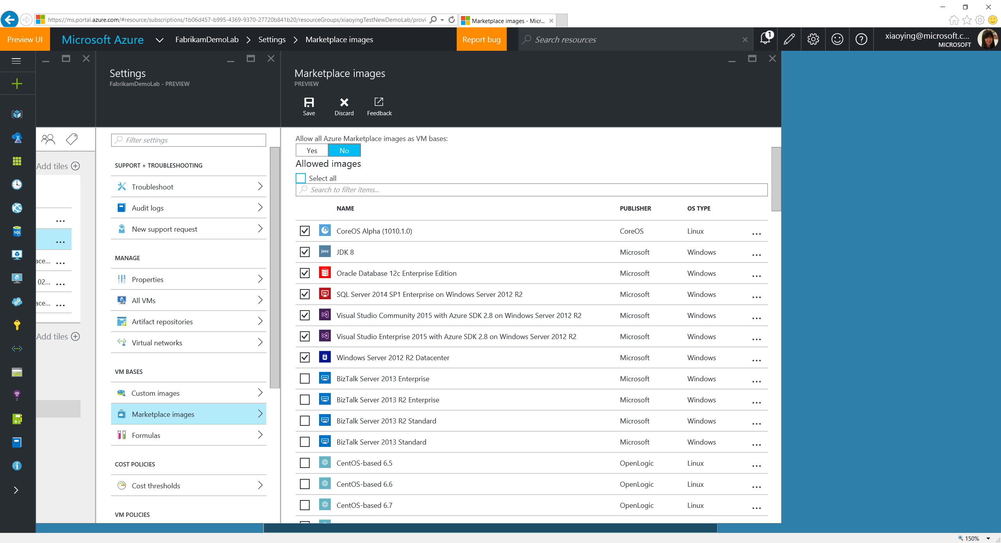
Notes:
Lab owners can whitelist marketplace images for the ones they want to allow in the lab for VM creation.

Slide 50
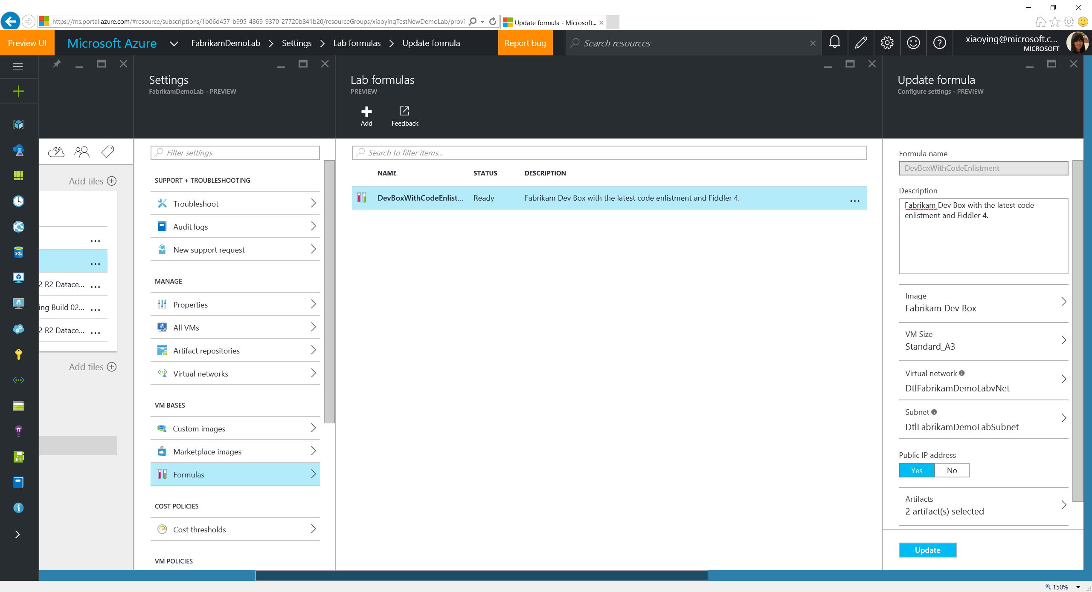
Notes:
Lab users can also create formulas from scratch and manage the existing ones.

Slide 51
Add Lab Users

Slide 52
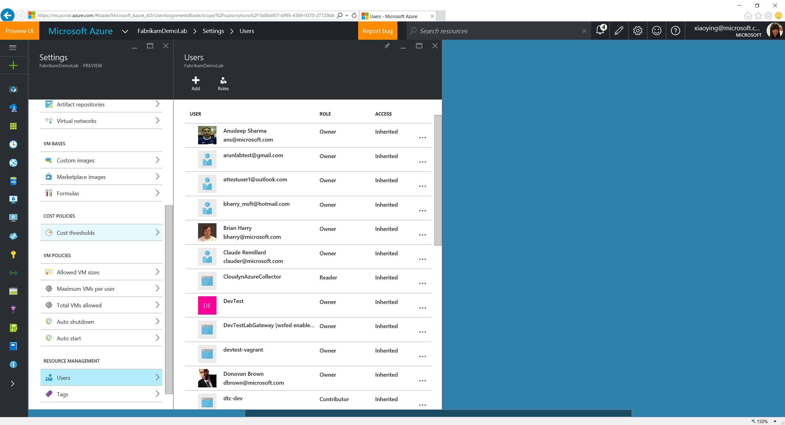
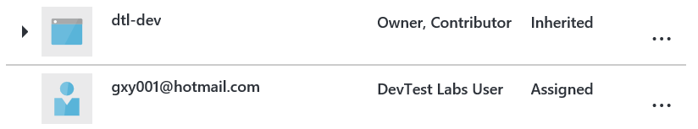
Notes:
Lab owner can add more users to the lab as a DevTest Labs user, who can only create VMs and manage their own VMs.

Slide 53
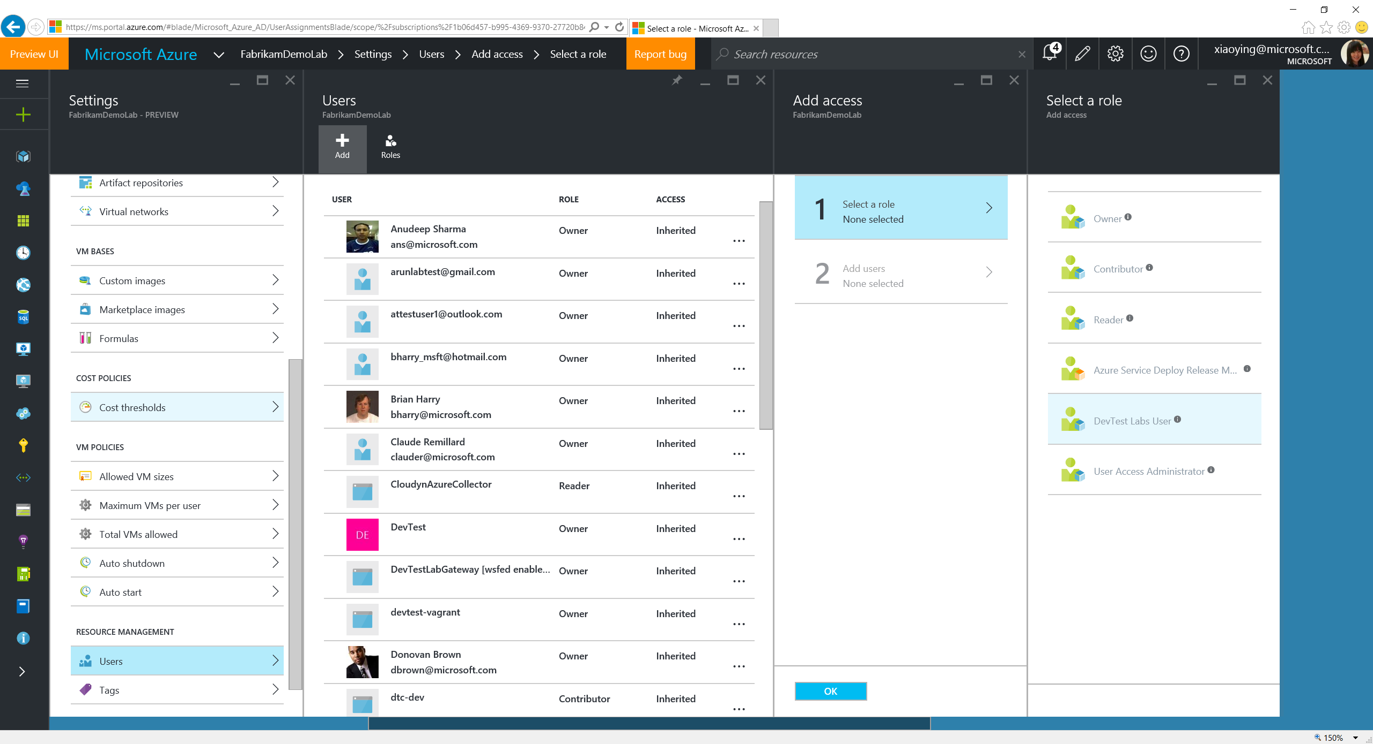
Notes:
Select “DevTest Labs Users” role.

Slide 54
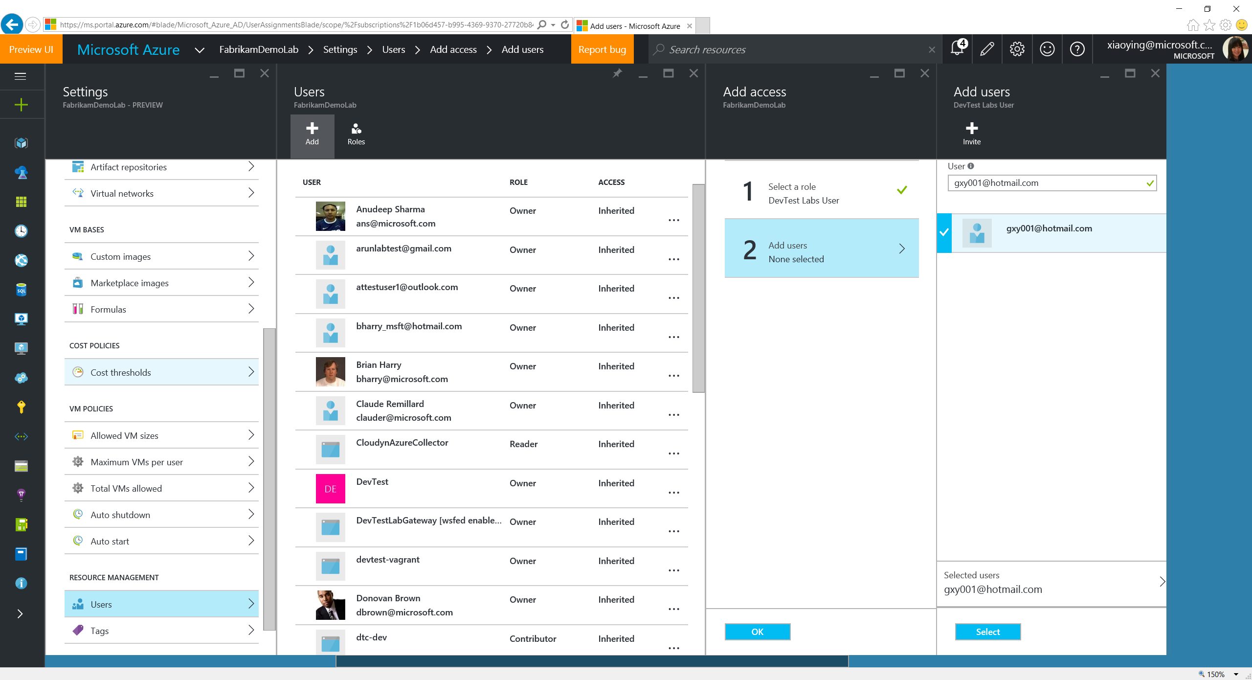
Notes:
Users are not necessarily to be in the Azure Active Directory, as long as they have a valid Microsoft account.

Slide 55
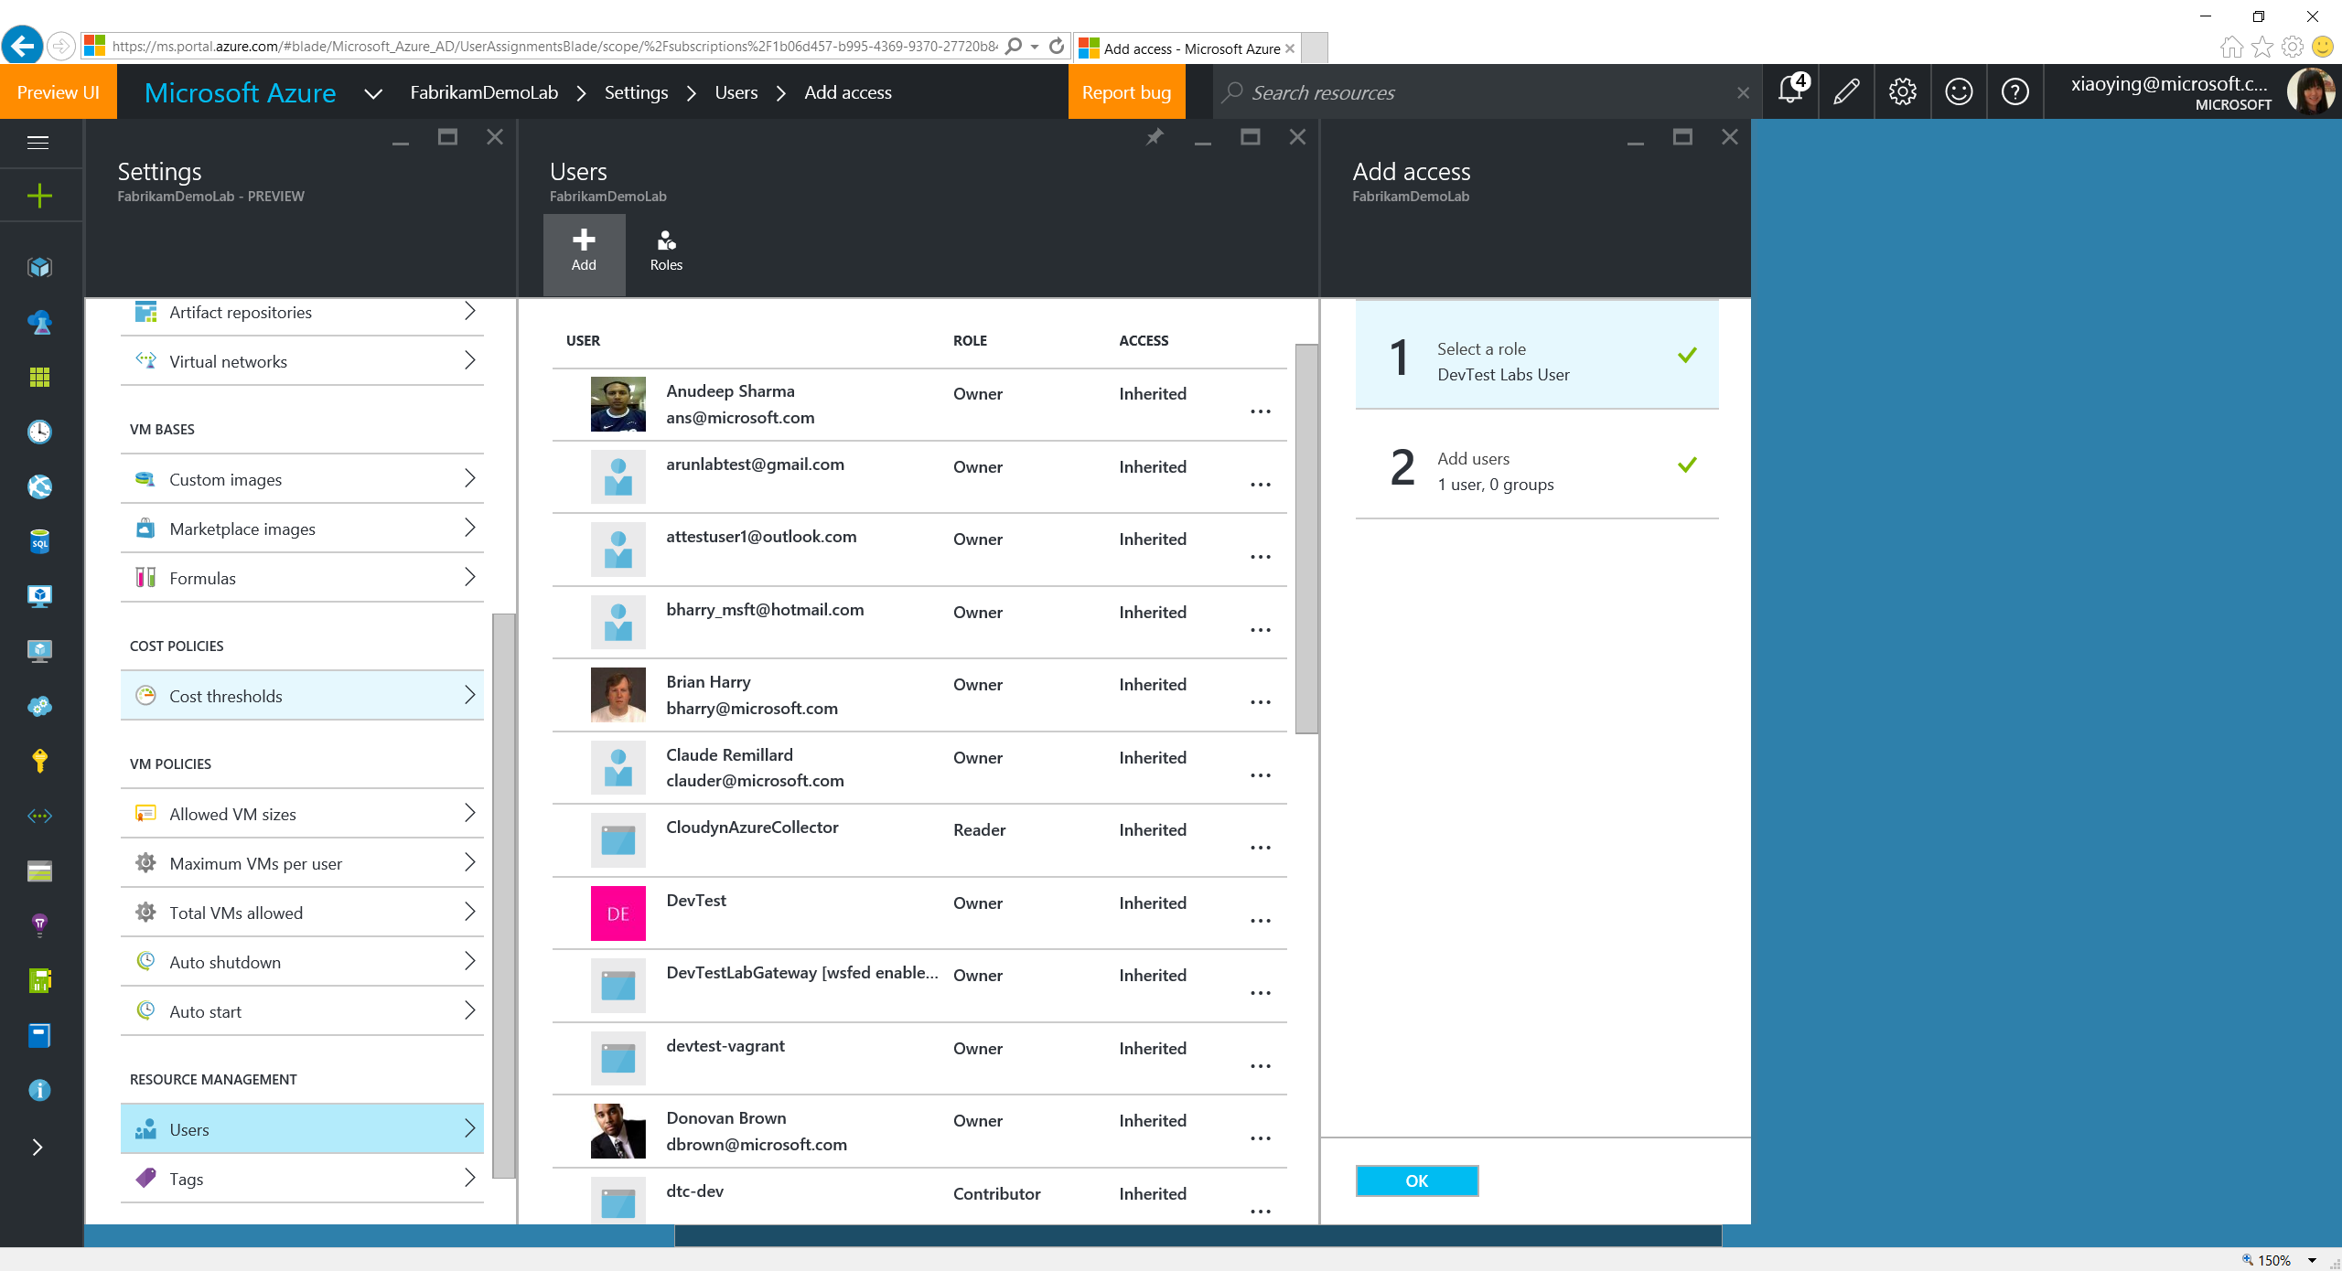
Notes:
Click OK to add the user as a DevTest Labs User.

Slide 56
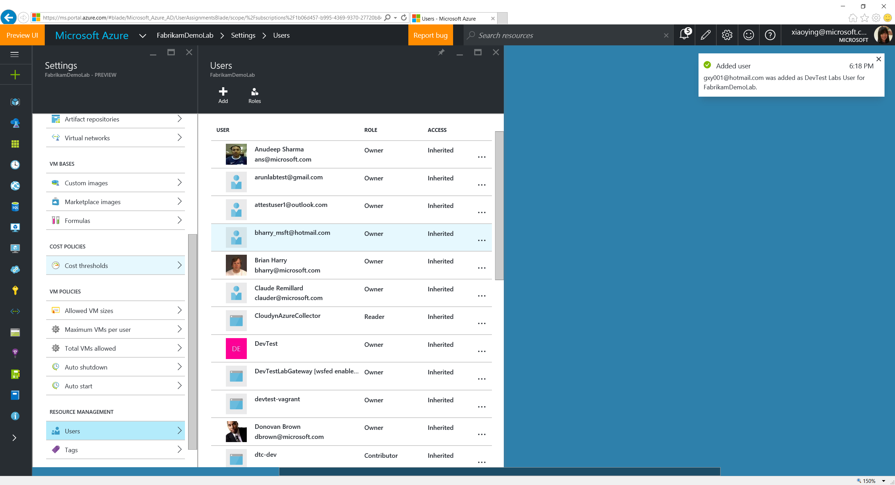
Notes:
User is successfully added.

Slide 57
Create a VM

Slide 58
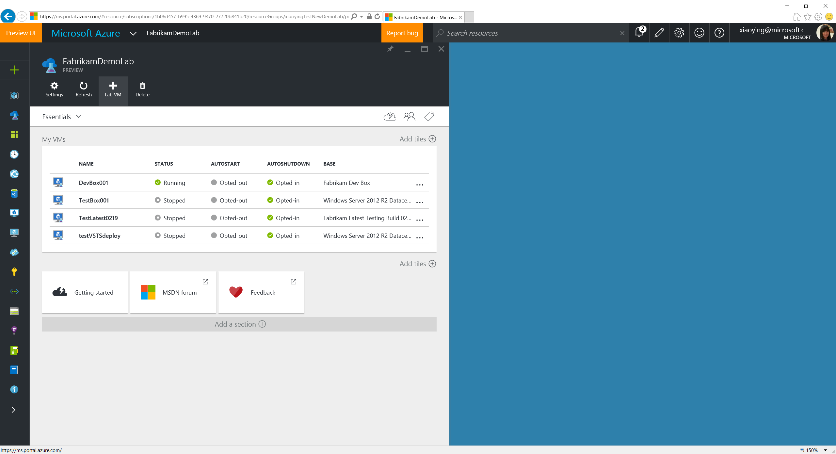
Notes:
Click the Add Lab VM button on the top of the lab blade to create a new VM in the lab.

Slide 59
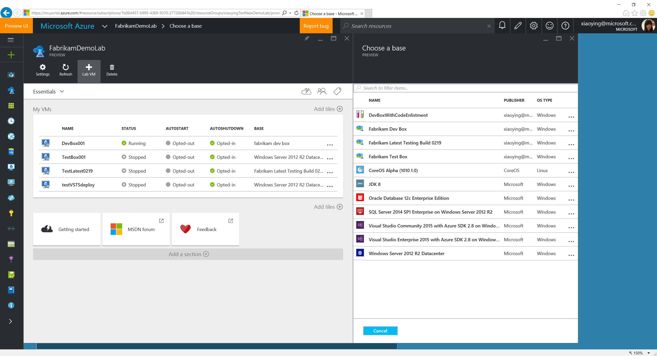
Notes:
Lab VM creation starts with choosing a VM base. The base list consists of formulas, custom images and Azure Marketplace images. Formula is a template with pre-defined values to the lab VM creation settings. Custom images are from the VHDs added into the lab. Lab owner can whitelist Azure Marketplace images allowed to show up in the lab VM base.

Slide 60
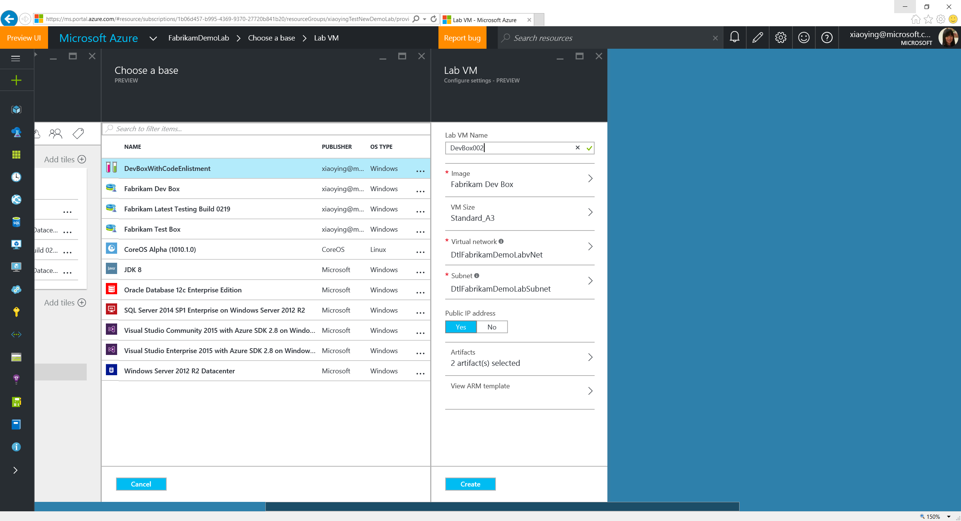
Notes:
Choose a Formula where you can see most of the settings have pre-defined values.

Slide 61
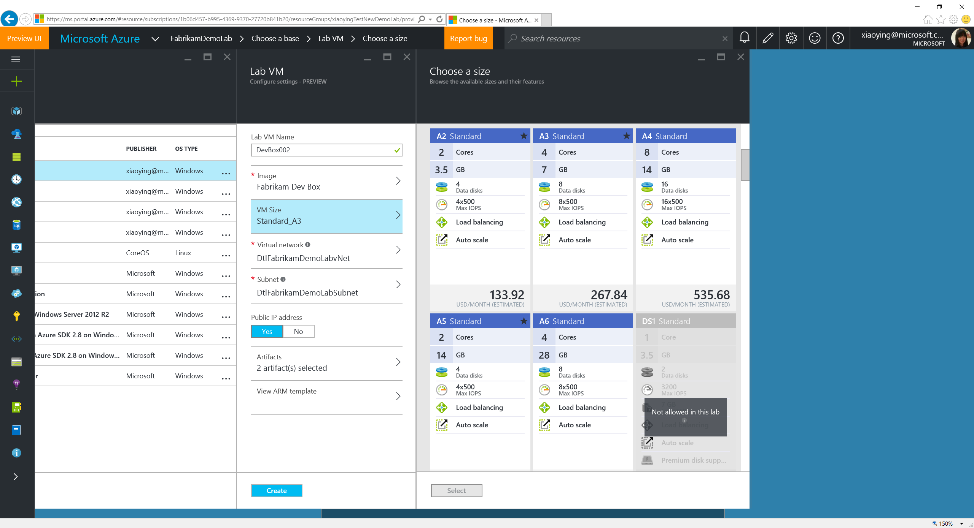
Notes:
Select a VM size. What’s allowed to be selected is based on the Allowed VM Sizes policy set in the lab.

Slide 62
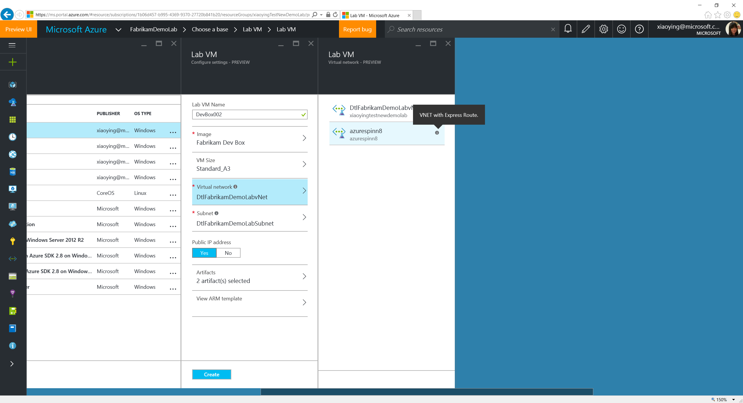
Notes:
Only allowed VNET can be selected.

Slide 63
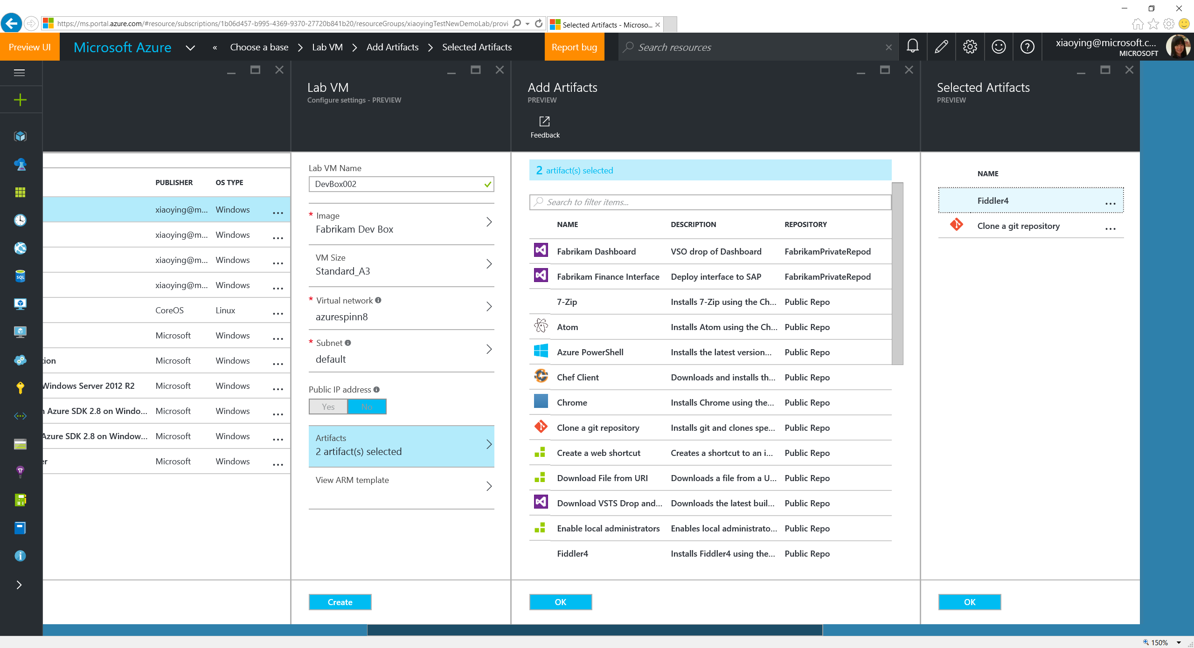
Notes:
2 artifacts have been selected with this Formula to enlist code and install Fiddler4. More can be added and the added one can also be updated based on real needs. In general, artifacts allow you to install apps or run system configurations right after the VM is created with the base image. Labs comes by default with a lot of artifacts stored in a public GitHub repo that you can reuse immediately after a lab is created.

Slide 64
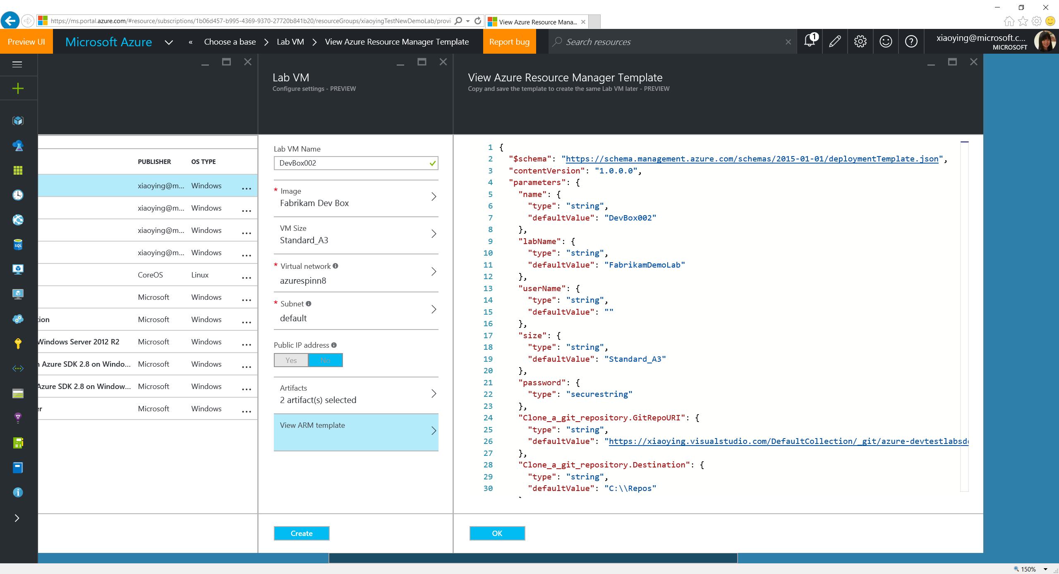
Notes:
You can also view the ARM template content that will be used for this VM creation. You can copy and save it for later reuse (through ARM template deployment) when desired.

Slide 65
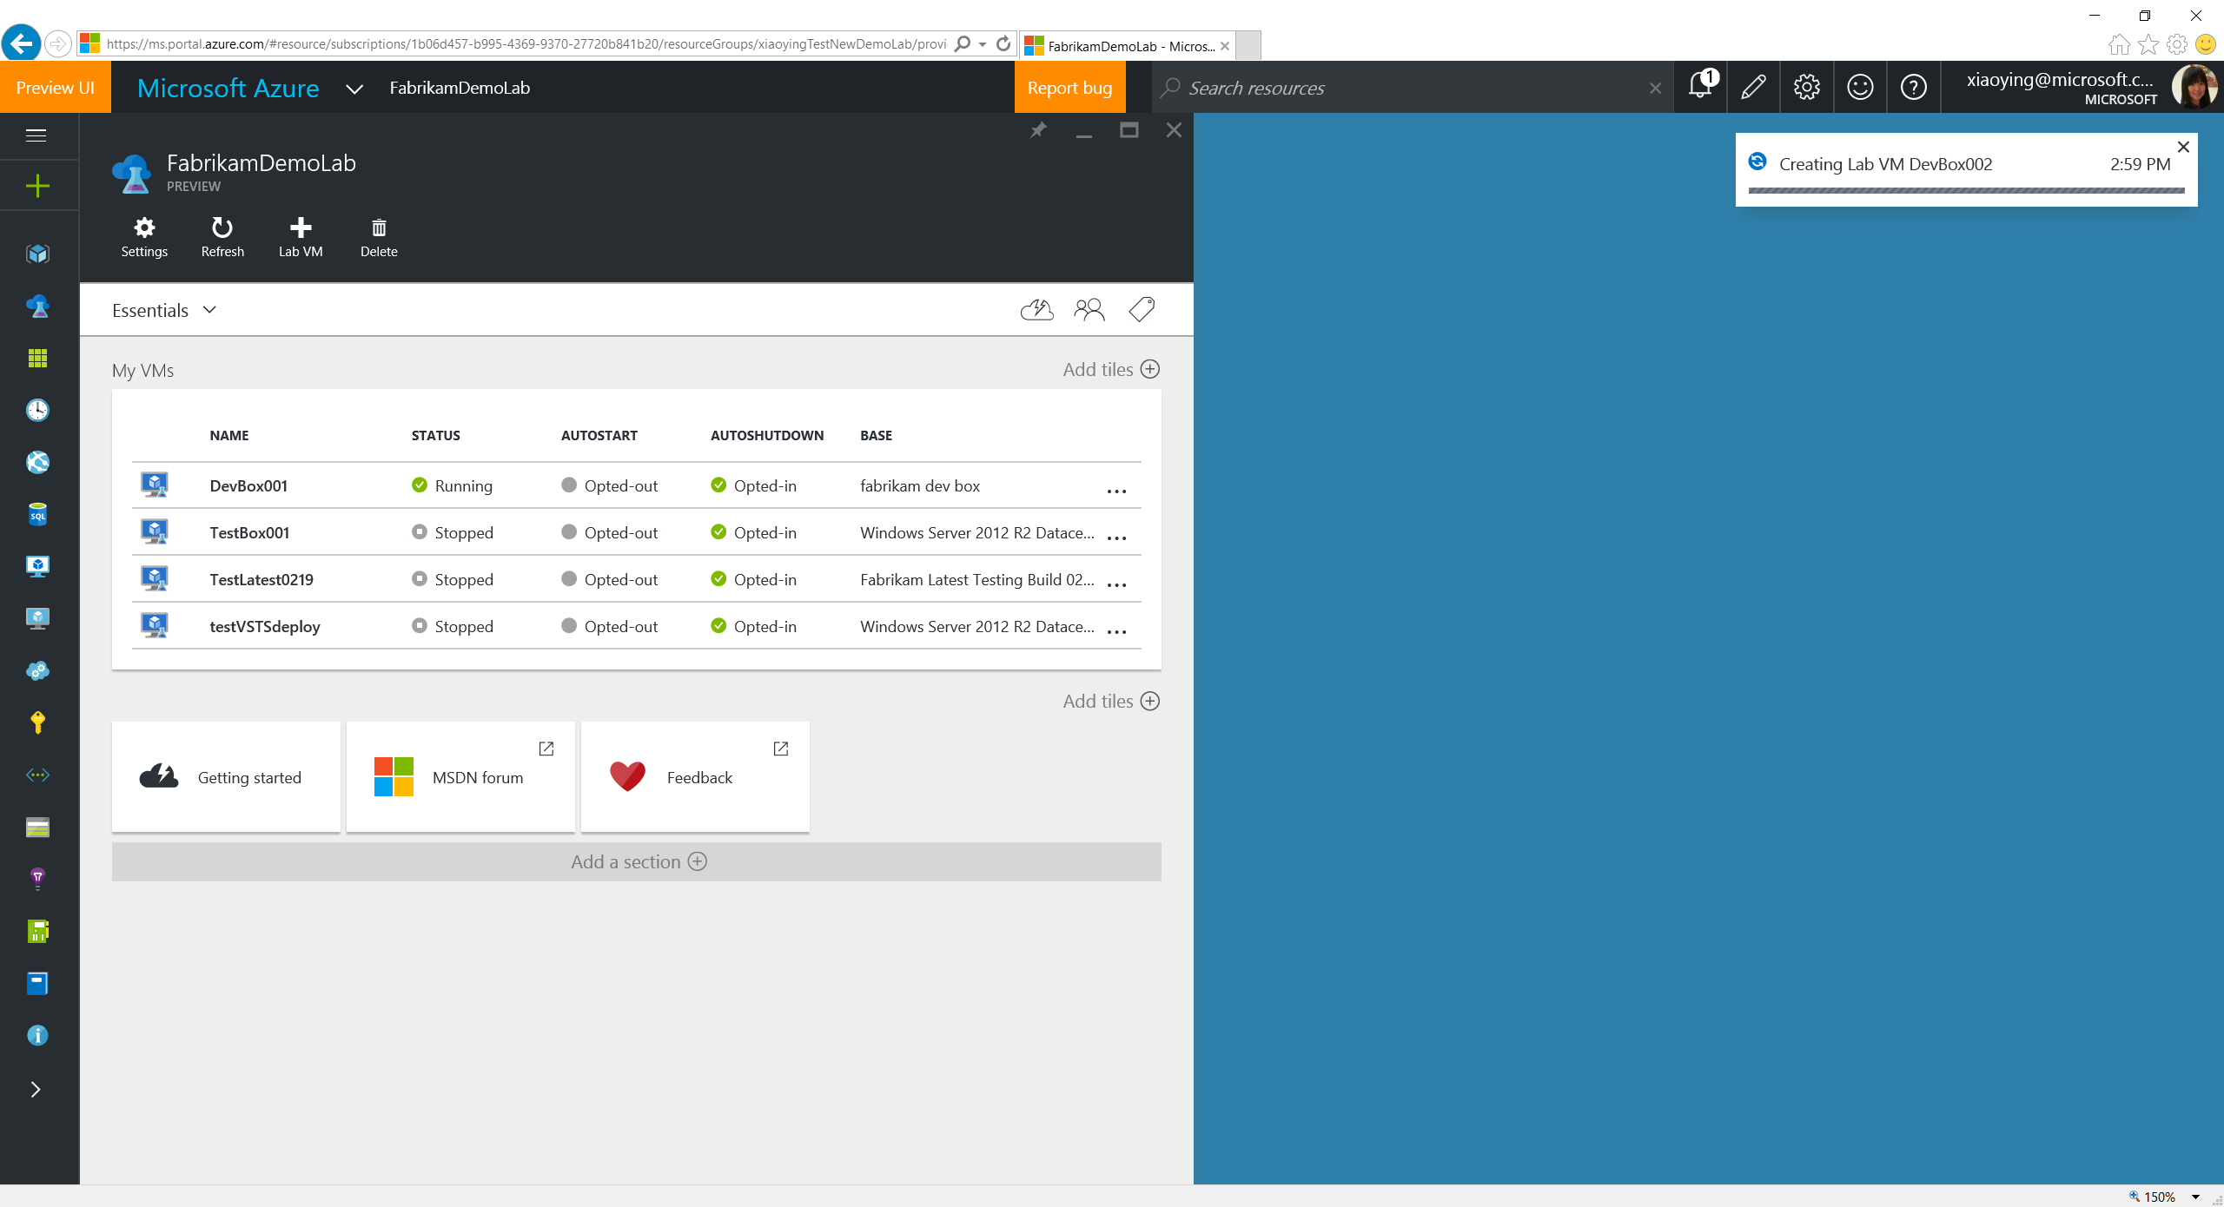
Notes:
Lab creation is in progress…

Slide 66
Manage Existing VMs

Slide 67
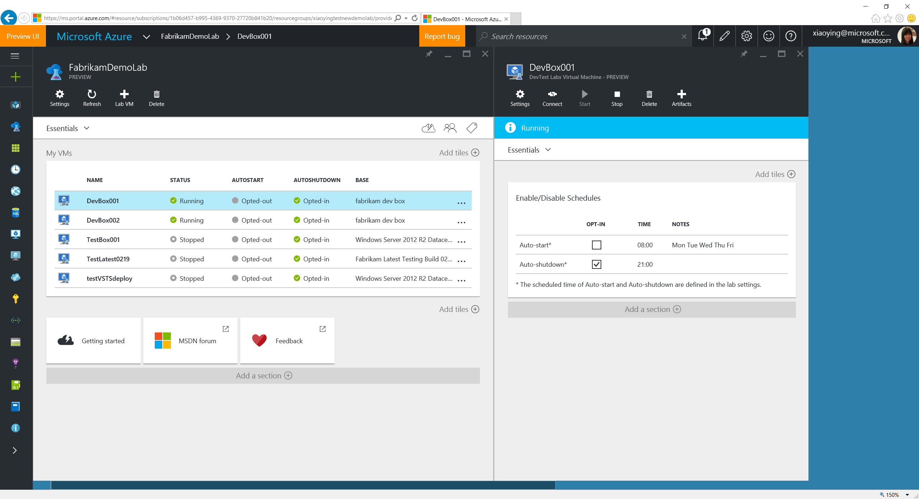
Notes:
Select an existing VM to open the lab VM blade. View the auto-shutdown/auto-start status.

Slide 68

Notes:
Select to opt-in auto-start policy. Users can also select to opt-in/out auto-shutdown/start policies here.

Slide 69

Notes:
Select “+ Artifacts” to install more apps or run configurations onto the VM (e.g. add a Docker container for new tests, install a new Dev tool that helps debugging) through artifacts without tedious manual operations.

Slide 70

Notes:
Lab VM blade Settings allow to create custom image or formula from the VM, to add tags or do troubleshooting.

Slide 71

Notes:
Create a custom image from the existing lab VM. The image will be saved in the lab and become available to all the lab users to create VMs.

Slide 72

Notes:
Or, simply create a formula, which is a template file that stores all the setting values used when this VM is being created (except the secure strings). It saves the storage space, and allow artifacts to play a role for installing things that can change over the time.

Slide 73

Notes:
A view for all the VMs is available through lab Settings -> All VMs.

Slide 74
We seen today…
Create a lab
Set policies
Set virtual networks
Configure artifact repositories
Manage VM bases
Add lab users
Create a VM
Manage existing VMs
Price

Slide 75

Price$$$
Notes:
Price

Slide 76

Thanks!
http://aka.ms/MTS84

